Slide 2
Plasma current collection of high voltage solar array:
numerical investigation
S. Hess¹, J-M Siguier¹, V. Inguimbert¹, D. Payan², A. Gerhard³
¹ ONERA
² CNES
³ Airbus Defense and Space

Slide 3
Motivation and context
Solar panels are key but sensitive elements of spacecraft.
They are composed of various materials with different electrical properties.
It leads to differential charging of the spacecraft surfaces and potentially to electrostatic discharges.
Because of the wide range of scales of the panel elements, it is difficult to model and solar panels involving new technology/layout require experimental tests.
All configurations cannot be tested => interest for accurate simulations.

Slide 4
Motivation and context
The potential of the spacecraft are strongly dependent on the current collected by the large exposed surface of the solar arrays.
Current collection effect differs depending on the conductivity of the collecting material: dielectric (cover glass) vs conductive (structure). Small conductors (cell edges, interconnects) represent a small fraction of the surface and are usually neglected.
But small conductors may be strongly polarized: their effective collecting surface may be quite different from their geometrical surface, thus changing the current balance at the global (spacecraft) scale.
Must be taken into account to have realistic computation of the spacecraft potential, but cannot be resolved spatially.
Need for models of the current collection by small conductive elements.

Slide 5
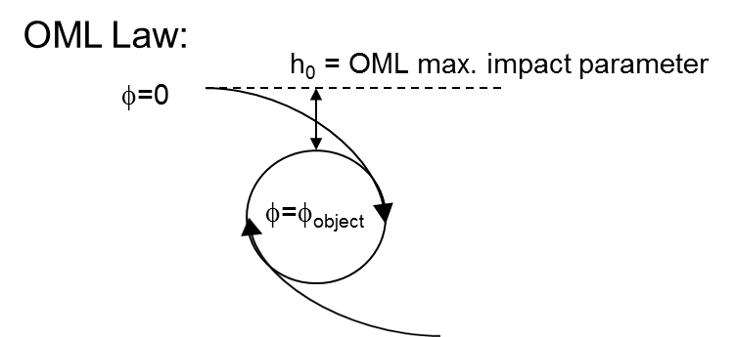
Previous work
Mandell and Katz (1983):
NASCAP-LEO, biased pinhole model (~ OML).
SPIS-GEO (2013):
OML (default) approximation
Limitations:
The simulation only split the unaffected total collected current towards conductor and dielectric: simulation of interconnects on an ITO cover panel has no effect.(even with 300V interconnects in a 0.1 eV plasma)
Only collected current, no emitted one (no snap-over)
Computation is averaged over the surface: impossible to identify what happen for a single (worst, typical,…) interconnect.
Panel current circuit is not simulated: no power loss computation…
Second order effects at the interconnects neglected (erosion, secondary currents,..)

Slide 6
Previous work
Mandell and Katz (1983):
NASCAP-LEO, biased pinhole model (~ OML).
SPIS-GEO (2013):
OML (default) approximation
Mandell et al. (2003):
current collected by a 2D strip:
$$j_{OML}=\frac{n}{2πkT}\int_{−\frac{π}{2}}^{\frac{π}{2}}{cosθ\int_{\sqrt{−2qφ}}^{∞}{v^{2}\exp\left(−\frac{\frac{v^{2}}{2}+qφ}{kT}\right)}}H\left(v,θ\right)dvdθ$$
$H\left(v,θ\right)$ = 1 for open trajectories, =0 for closed ones.
$H(v,θ)$=1 for all trajectories: exact solution but not accurate OML factor for a strip:
In reality the incidence angle is not conserved (non isotropic distribution on the collecting surface).
Mandel et al. 2003, use <H> determined from simulation, as well as empirical potentials in the gap determined from Gilbert simulations. Results OK but only suited for a particular solar cell geometry.

Slide 7
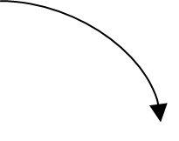
Modified OML law for plane 2D interconnects
Modified OML Law (acceptance angle):
OML: maximum impact parameter h₀. Effective collection surface multiplied by h₀/r.
Works for a cylinder in free space, particles arrive from all directions.
But for an interconnector on a solar panel, only some directions of arrival are possible.
The acceptance angle can be expressed as the following expression:
$∆i=∆i_{1}+∆i_{2}+∆i_{3}−π$
h_{n=1-2} / h₀ functions are sigmoid functions of $qφ/mv^{2}$ with a vertex around $qφ=mv^{2}$ determined using hyperbolic trajectories.
h₁
$$h_{1}/h_{0}=\left\{\begin{aligned} 1 ; qφ≪ mv^{2} \\ \frac{(1−\sin{Φ})}{2\cos{Φ}} ; qφ≫ mv^{2}\end{aligned}\right.$$
$$h_{2}/h_{0}=\left\{\begin{aligned} 0 ; qφ≪ mv^{2} \\ 1 ; qφ≫ mv^{2}\end{aligned}\right.$$
$$h_{3}/h_{0}= \tan{Φ}$$
h₂
h₃
Cover glass
Cell

Slide 8
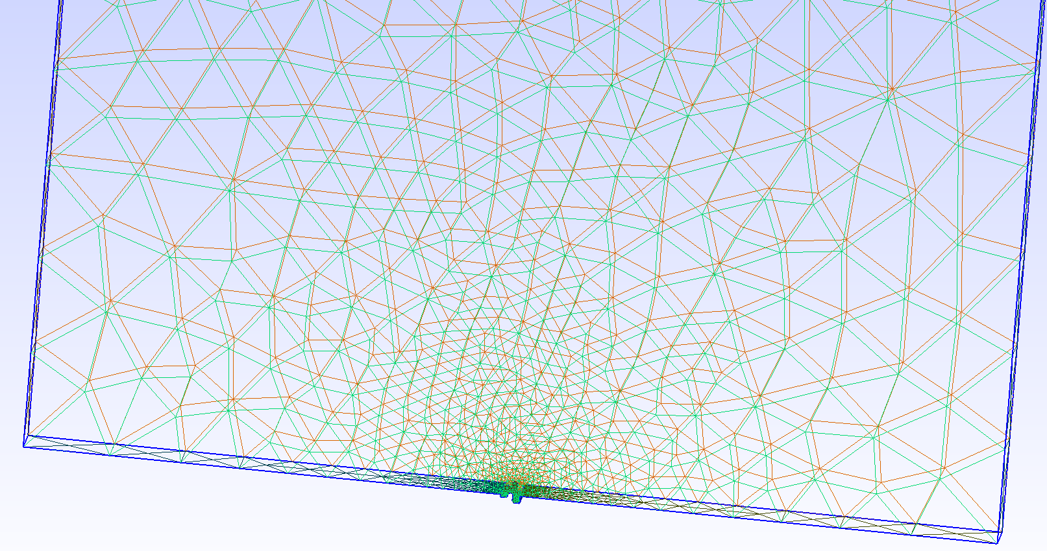
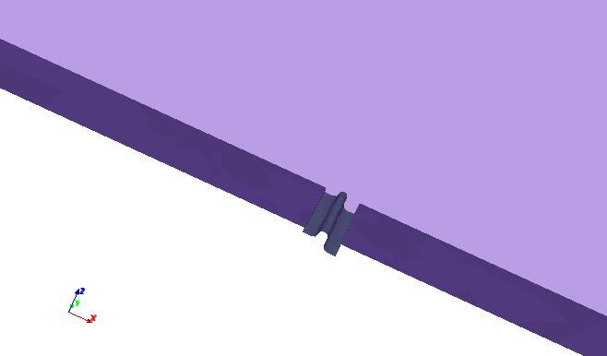
Simulations
We perform simulation of the current collection by interconnects using SPIS (version DUST-5.1.8).
The simulation domain: 4 x 4 x 0.2 cm box.
Top face open to ionosphere plasma, sides reflective.
Bottom made of cover glass except for a 0.8 mm wide gap at the centre of the domain in which the metallic interconnect is located.
Mesh
Geometry
The ionosphere : 10¹⁰m⁻³ 0.1eV Maxwellian electrons and ions at rest with respect to the solar panel.
Top boundary : potential fixed to 0V.
The cover glass : set to 0V, but may slightly evolve during the simulation.
The potential of the interconnect evolves from -1V to 1V by steps of 0.1V.

Slide 9
Simulation results
e- current (A/m²) +1V bias
Potential for bias +1V
ion current (A/m²) +1V bias

Slide 10
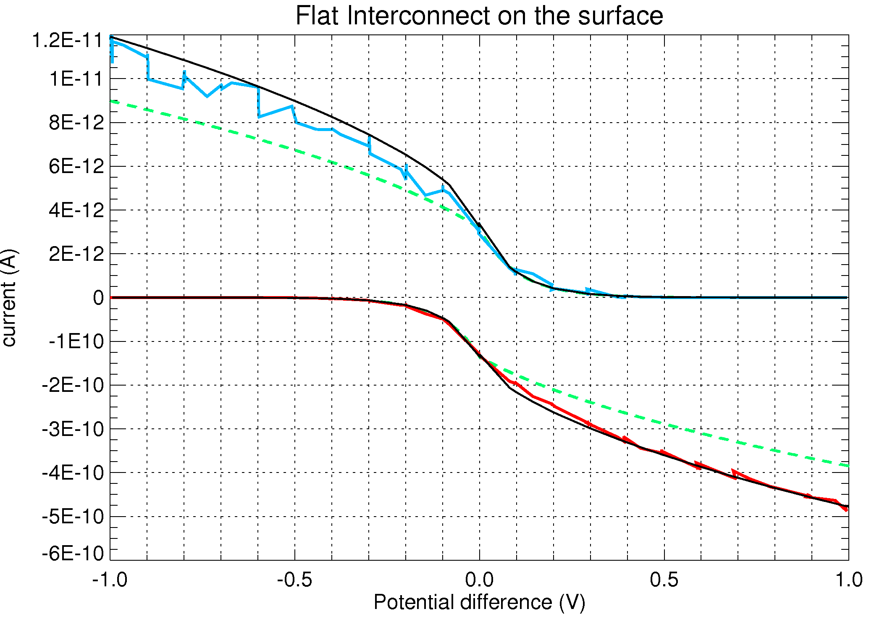
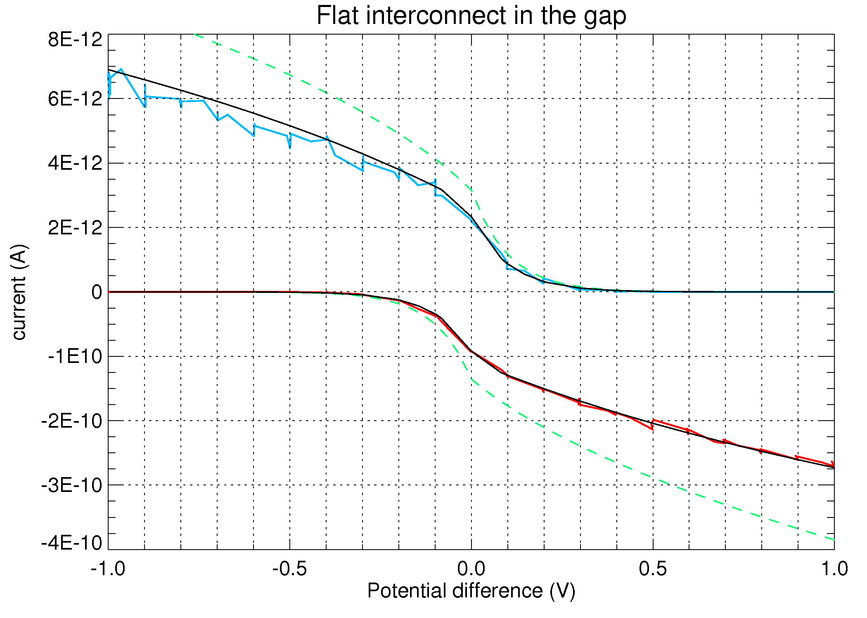
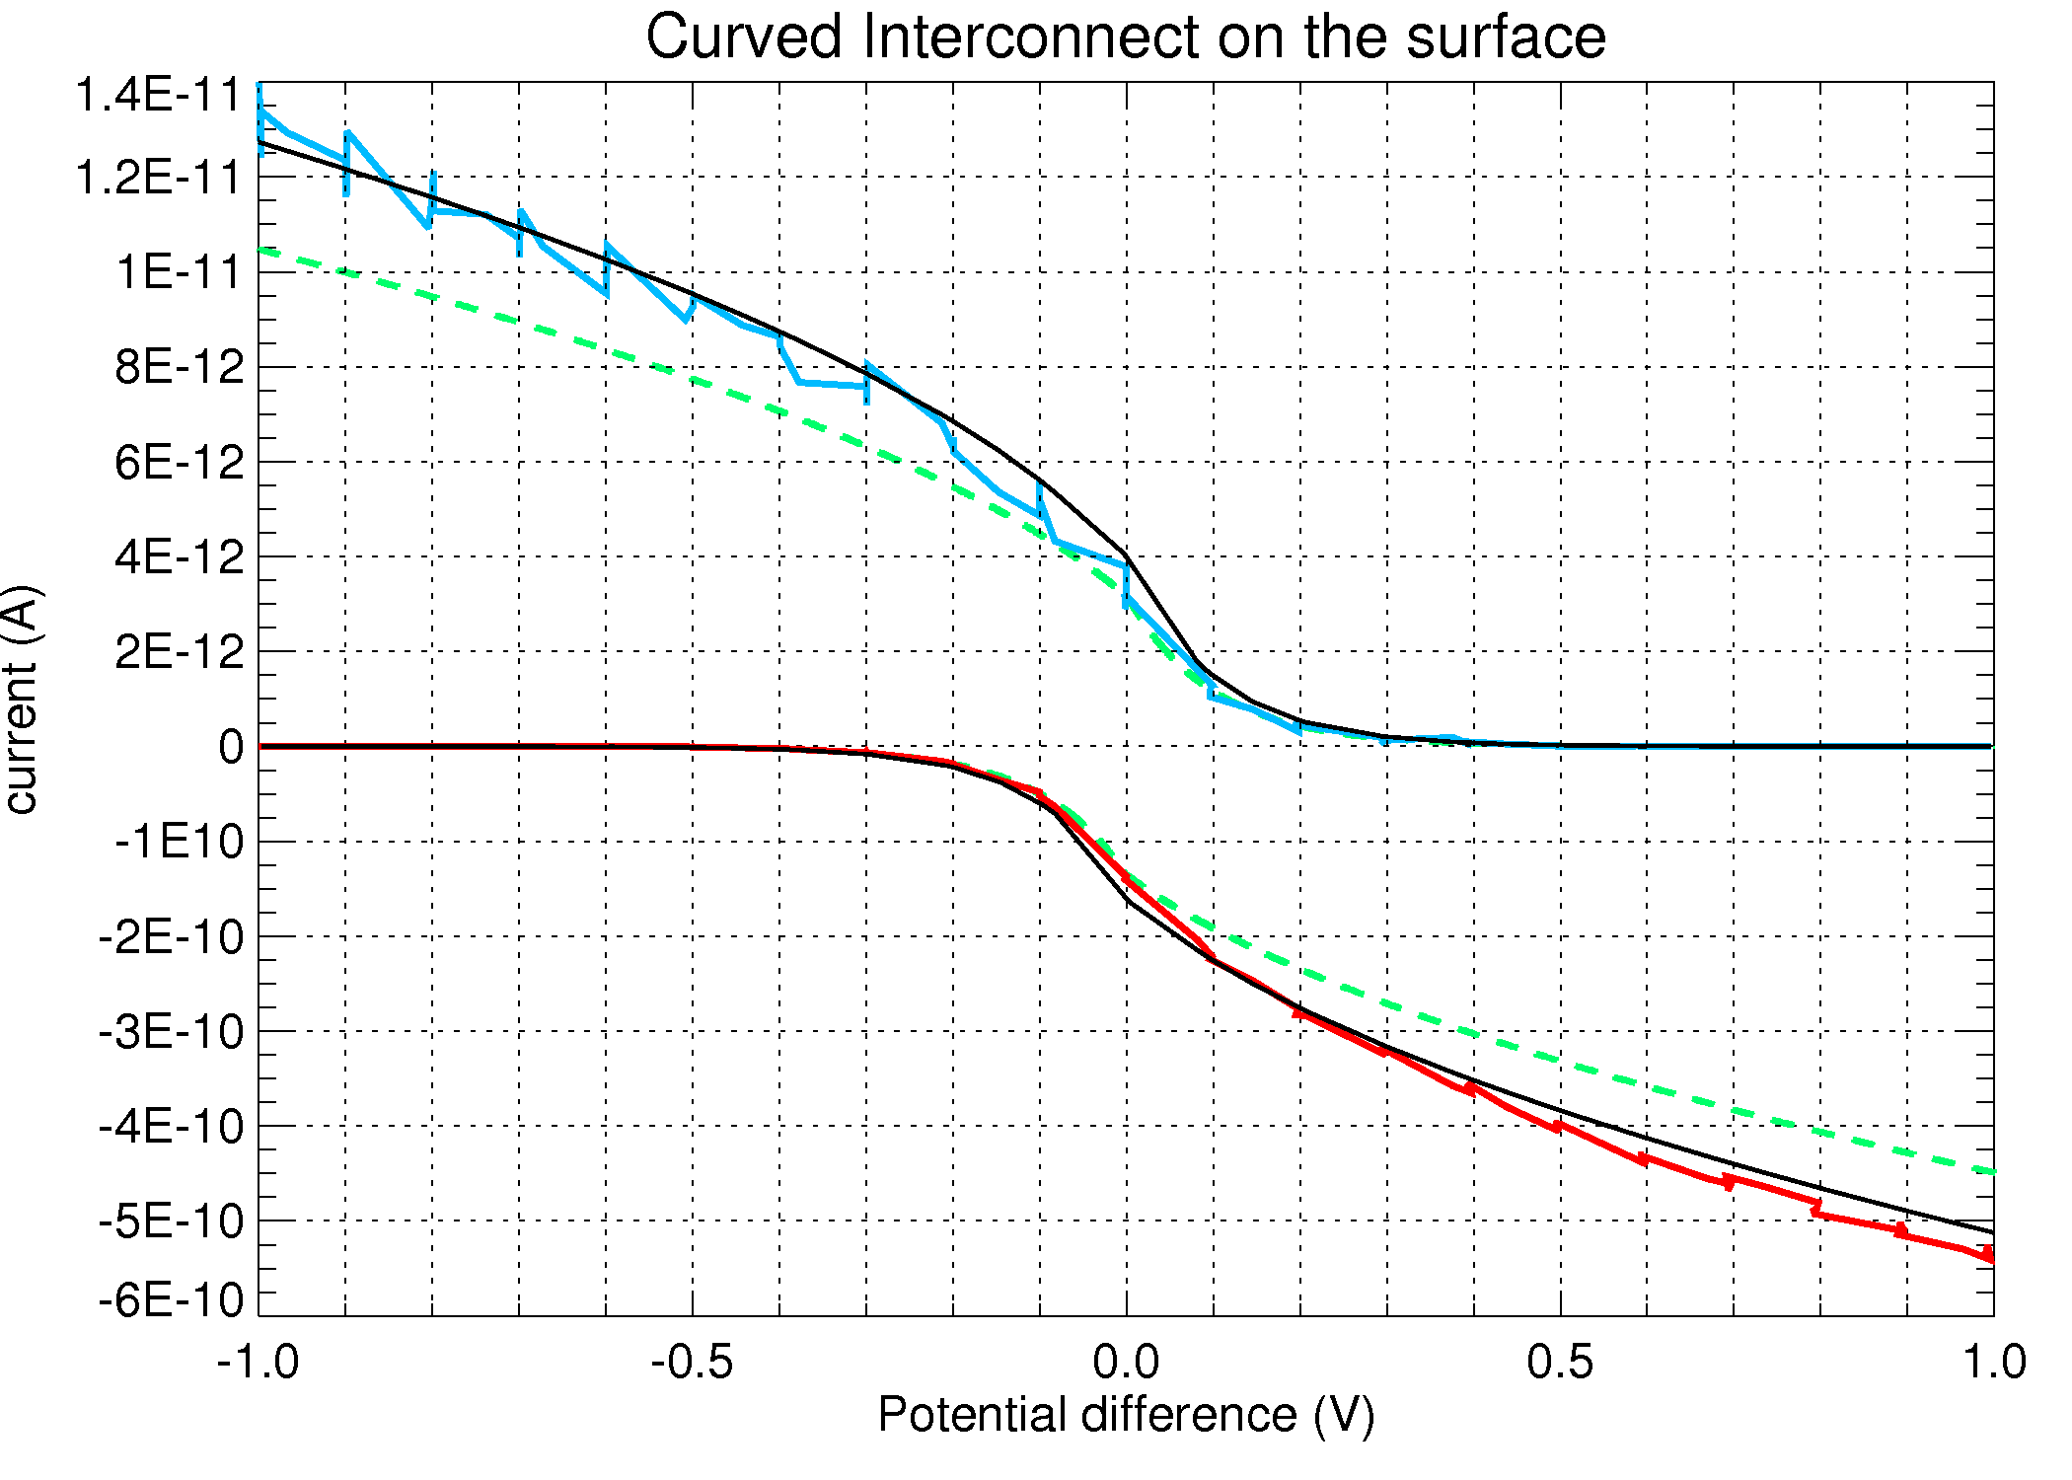
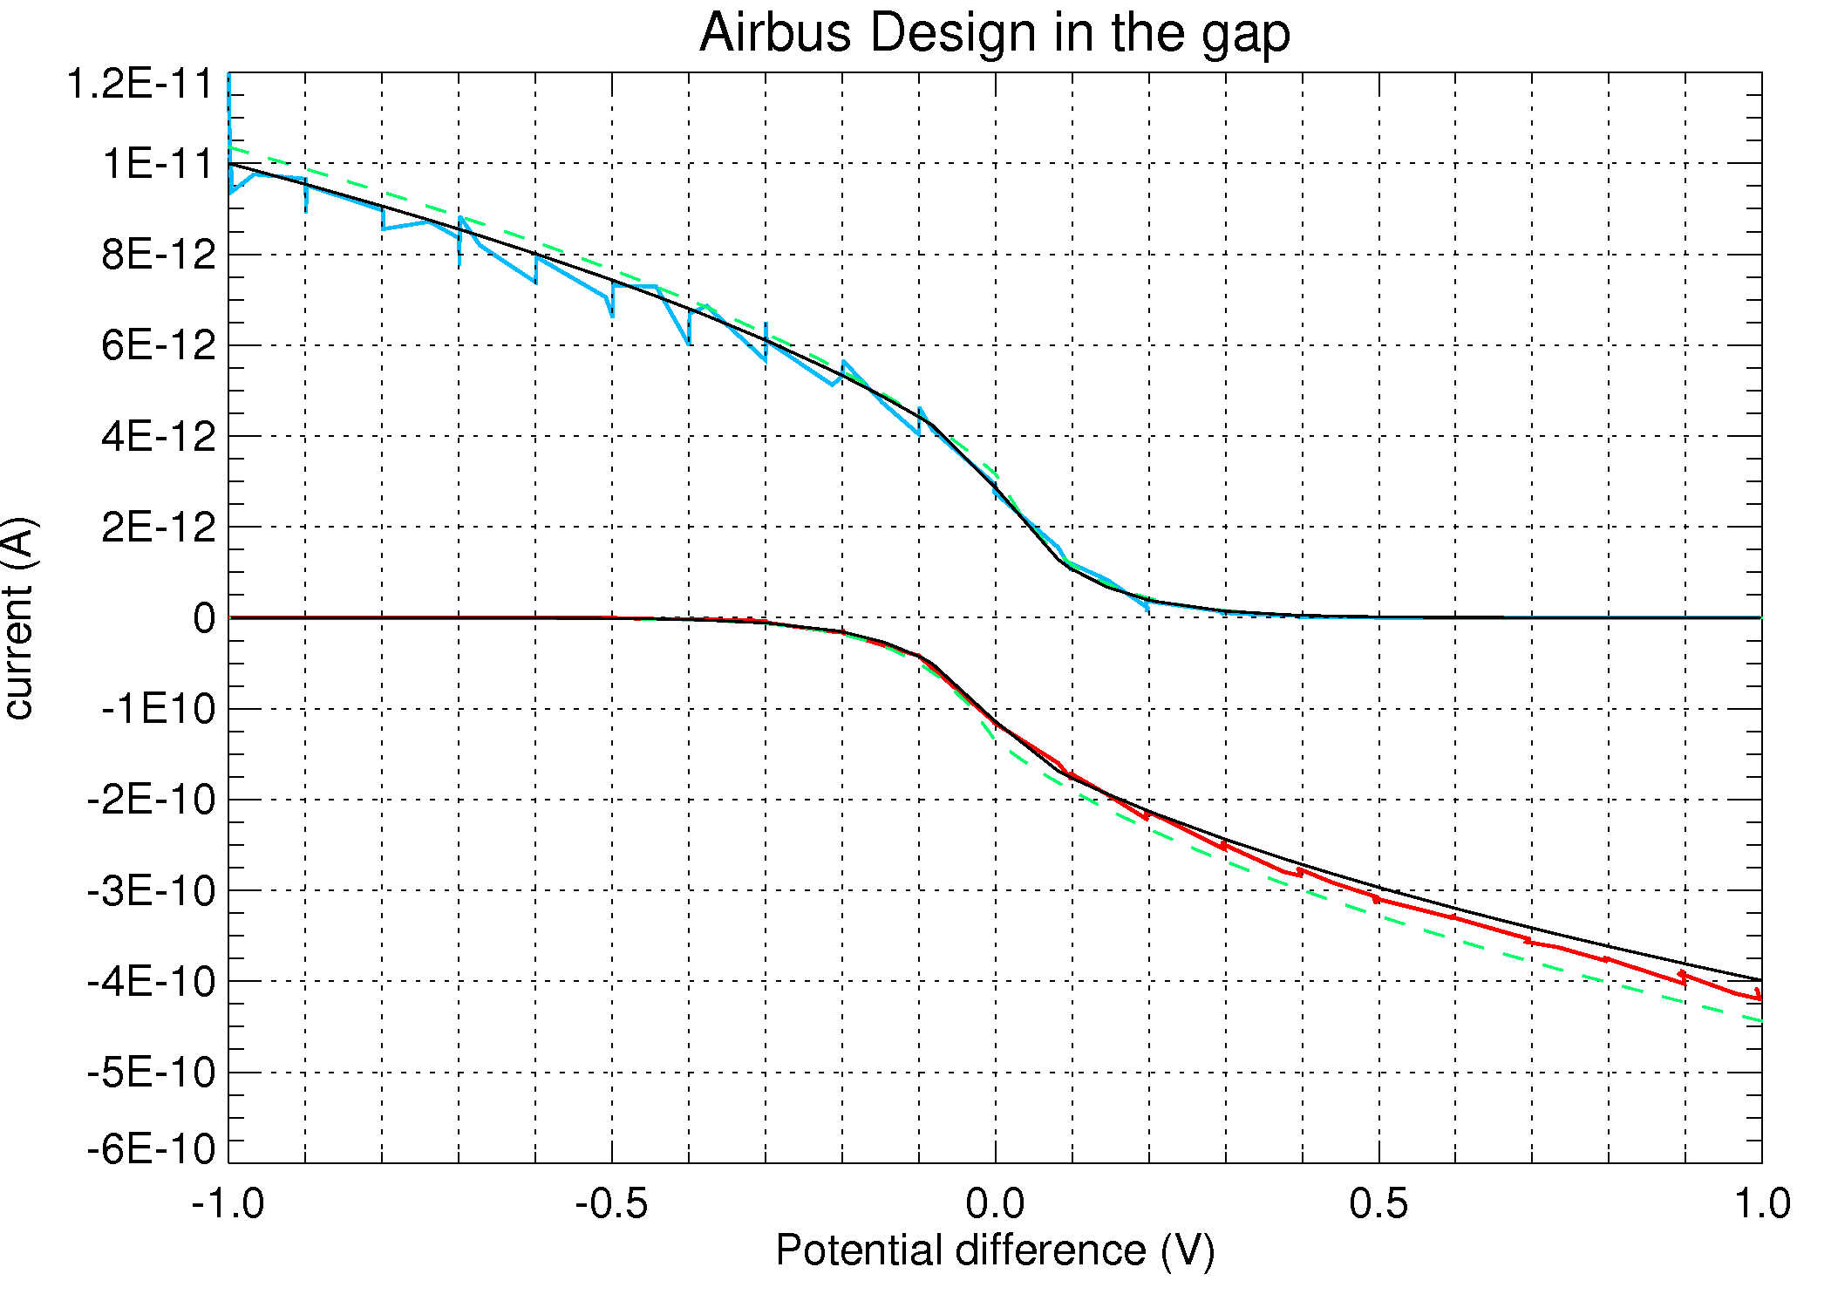
Comparison model – Simulations I- Moderate Voltage
On the surface Down the gap
Electron and ion currents collected by the interconnect.
Black: model
Green dashed: OML
Red: Simulation Electrons
Blue: Simulation H⁺
Curved interconnect in the gap

Slide 11
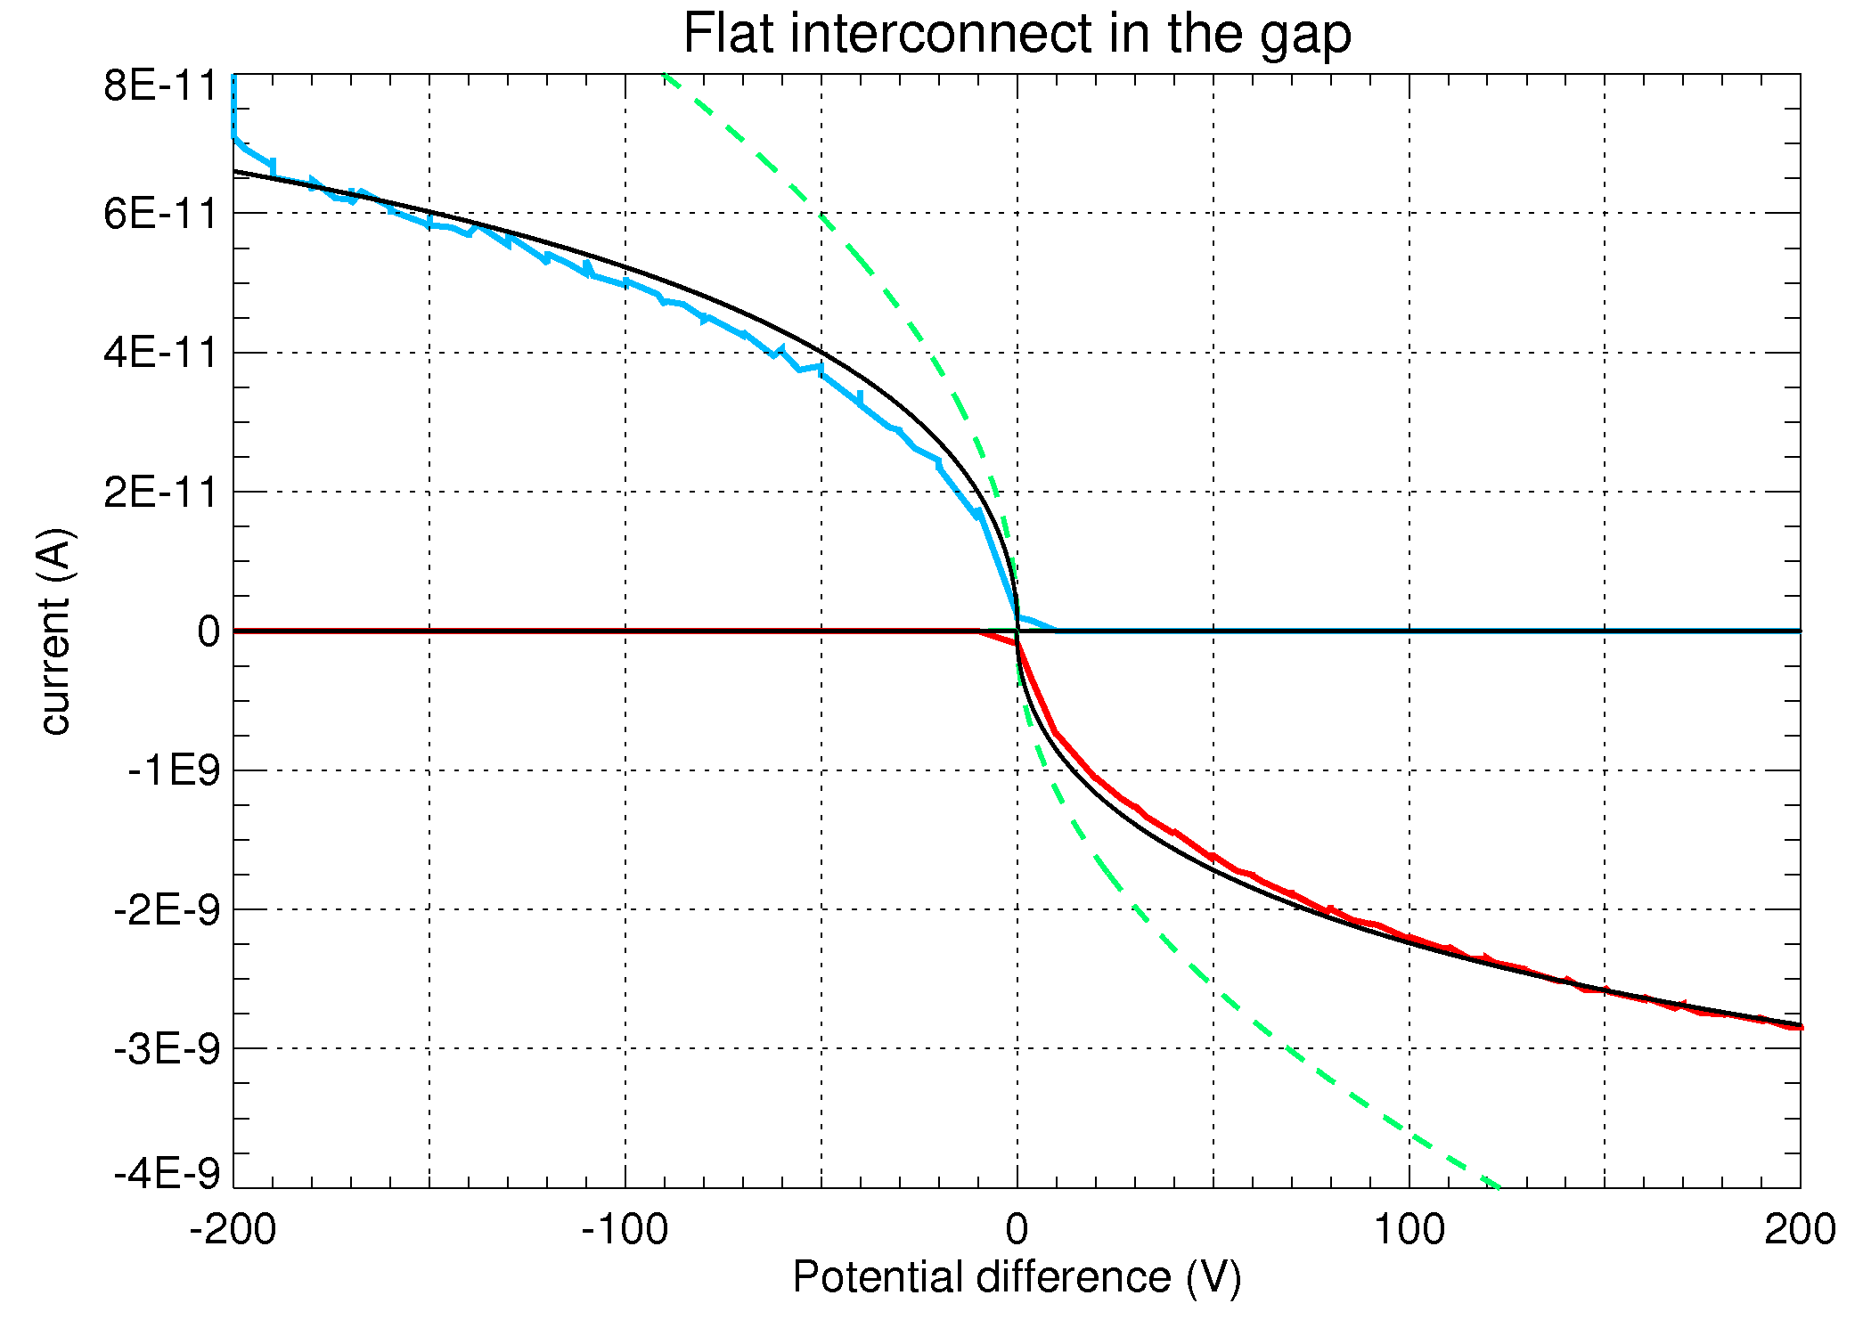
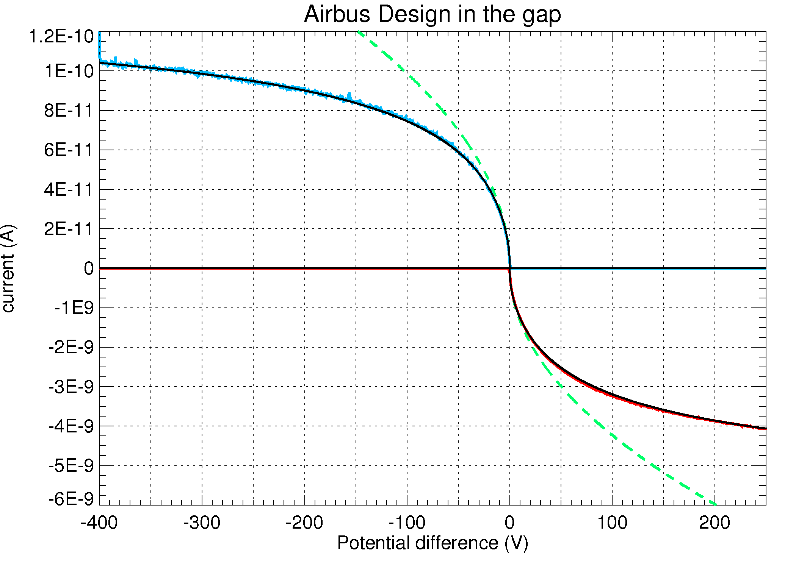
Comparison model – Simulations II- Higher Voltage
Curved interconnect in the gap
Current saturation due to finite cell surface
The model reproduces well the collected currents (including the recollection
of secondaries, not shown). This analytic model can thus be implemented in
SPIS to perform simulation at the panel/spacecraft scale.

Slide 12
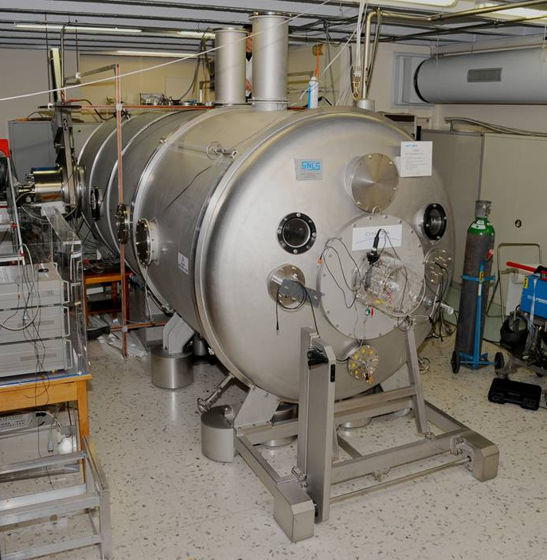
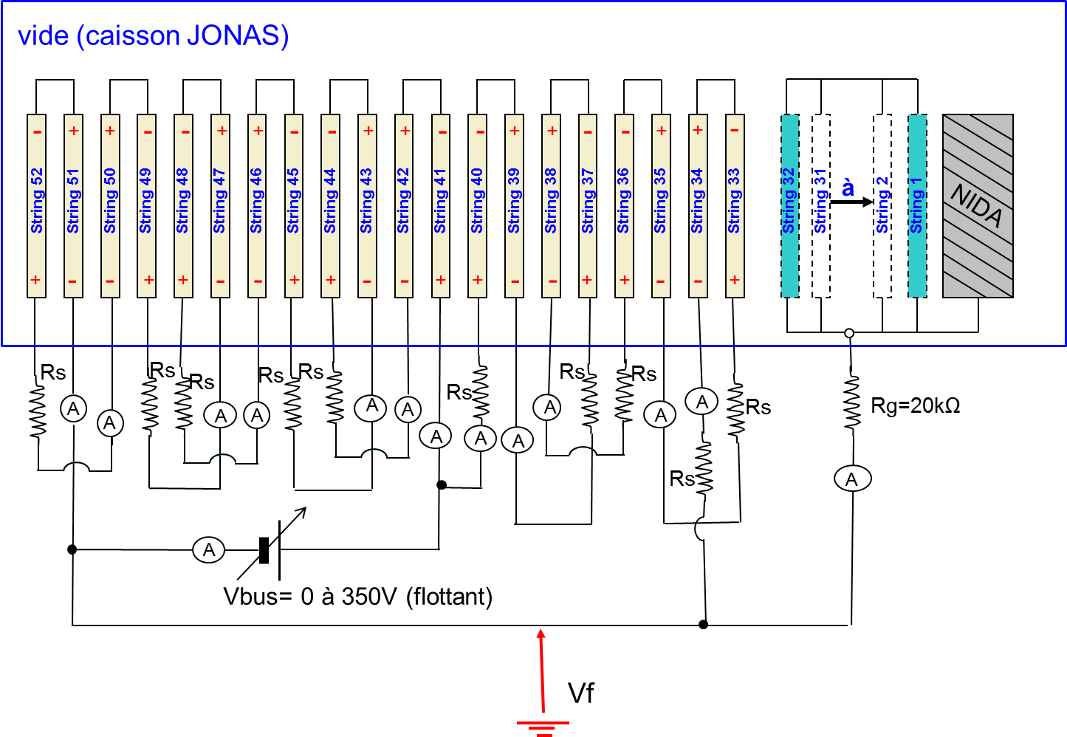
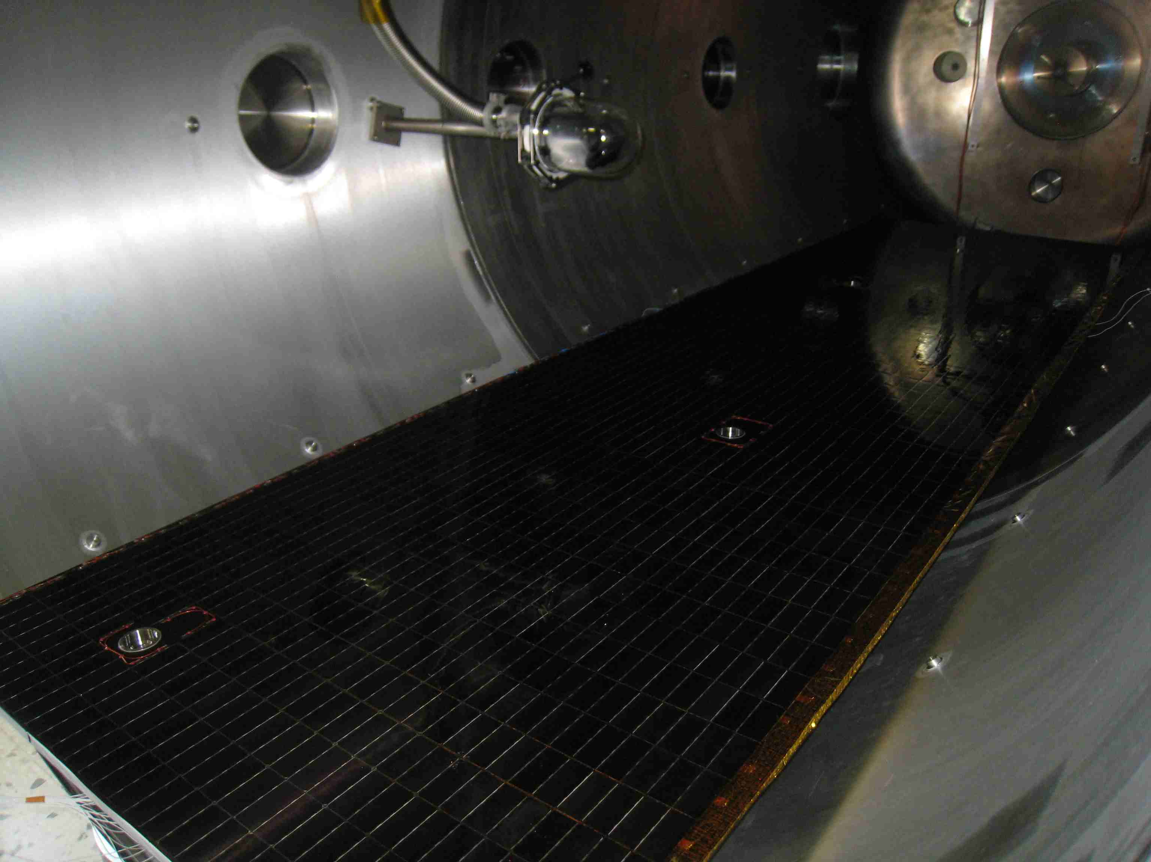
Comparison Experiment– Simulations I – Experimental set-up
Current collection experiment in ONERA’s
JONAS chamber
Floating solar panel in LEO plasma with high
voltage polarization of the interconnects.

Slide 13
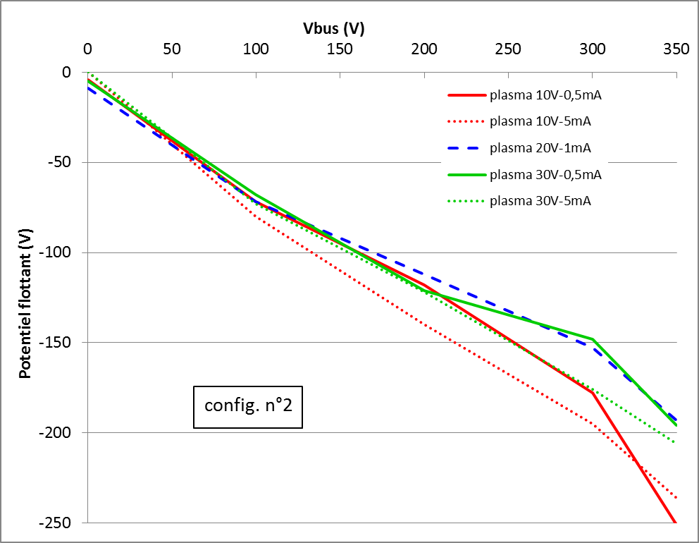
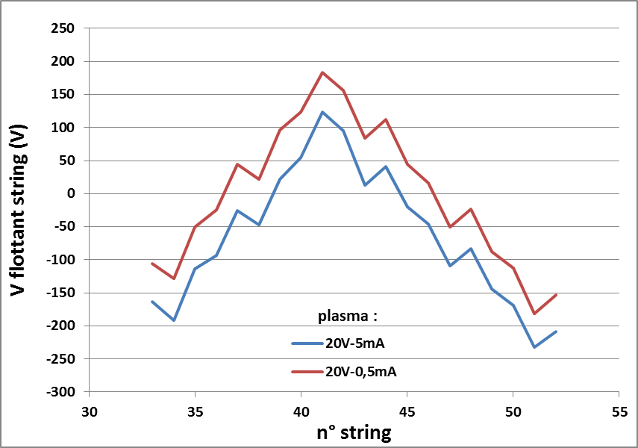
Comparison Experiment– Simulations I – Experimental set-up
Interconnects represent <2% of the surface
But their polarity determines that of the
whole panel.

Slide 14
Comparison Experiment– Simulations II – Simulation set-up
ONERA’s JONAS chamber is simulated with
the solar panel inside. Environment is tuned
to get as close as possible as JONAS one.
Impossible to reproduce the exact
wiring of the strings in the experiment.
A constant potential difference is applied
between strings so that the potential profile
along the panel is close to that of the experimental one.

Slide 15
Comparison Experiment– Simulations II – Simulation set-up
■
Interconnects represent <2% of the surface
But their polarity determines the potential
of the whole panel.
Simulations performed at various Vbus
voltage with plasma ~20V and 2mA
■
■
■

Slide 16
Comparison Experiment– Simulations II – Simulation set-up
Simulation with Vbus=350V. Initially the interconnects are all positive,
But the current they collect changes the whole solar panel potential to -240V
At the end, only a few strings have a positive potential.
The panel potential is almost only determined by the current balance on interconnects
Interconnect potentials t=40s Interconnect potentials t=500s

Slide 17
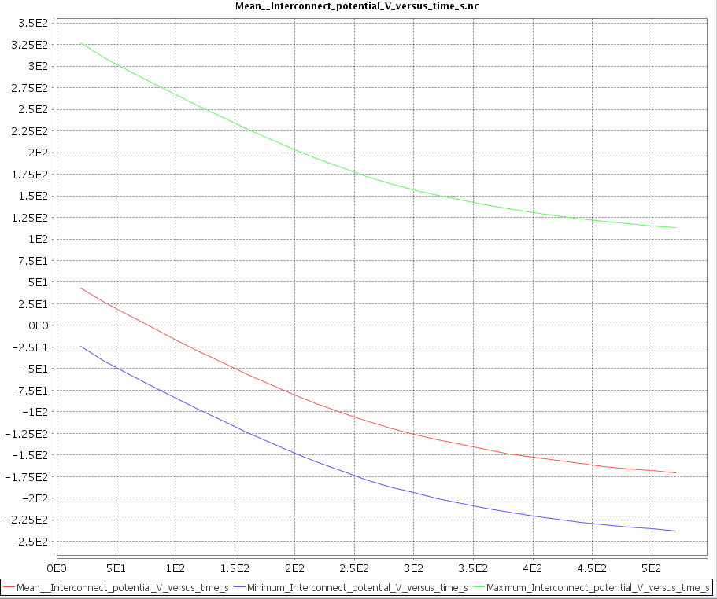
Comparison Experiment– Simulations II – Simulation set-up
Simulation with Vbus=350V. Initially the interconnects are all positive,
But the current they collect changes the whole solar panel potential to -240V
At the end, only a few strings have a positive potential.
The panel potential is almost only determined by the current balance on interconnects

Slide 18
Comparison Experiment– Simulations II – Simulation set-up
Simulation with Vbus =350V.
The effect of the interconnect polarization is visible on the cover glass surface
potential. High positive potential interconnects tend to collect all electrons.
Interconnect potentials t=0s Interconnect potentials t=500s
Surface potentials t=500s
Potential t=500s

Slide 19
Comparison Experiment– Simulations II – Simulation set-up
Simulation with Vbus =350V.
The effect of the interconnect polarization is visible on the cover glass surface
potential. High positive potential interconnects tend to collect all electrons.
Interconnect potentials t=0s Interconnect potentials t=500s
Surface potentials t=500s
e⁻ density t=500s

Slide 20
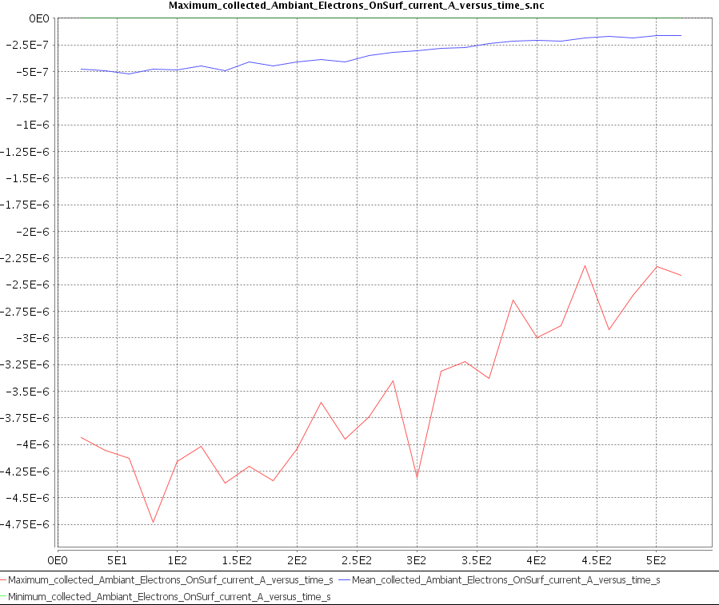
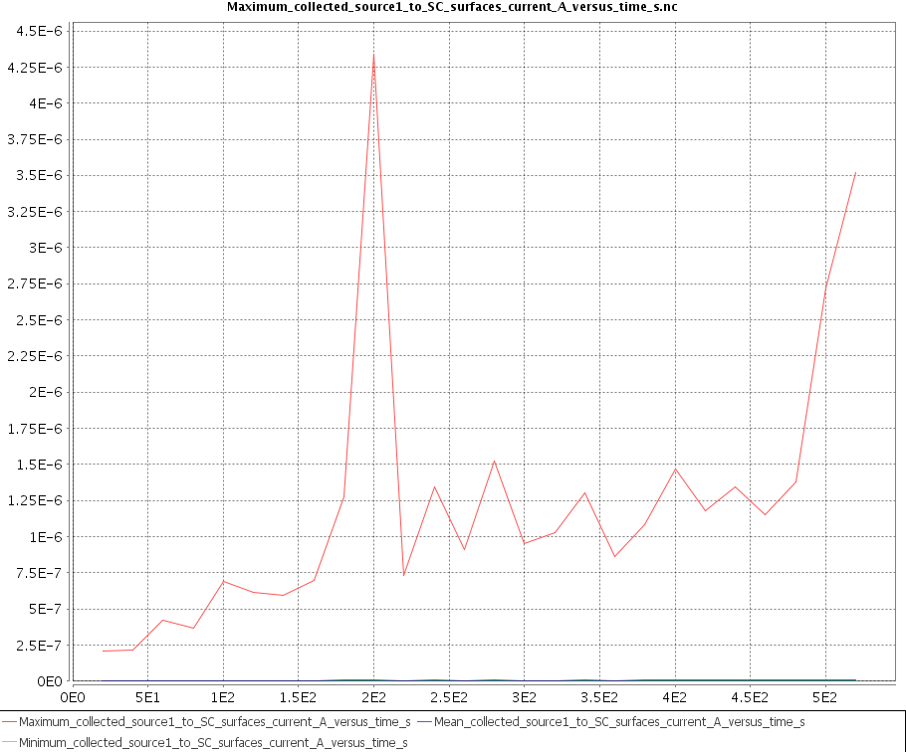
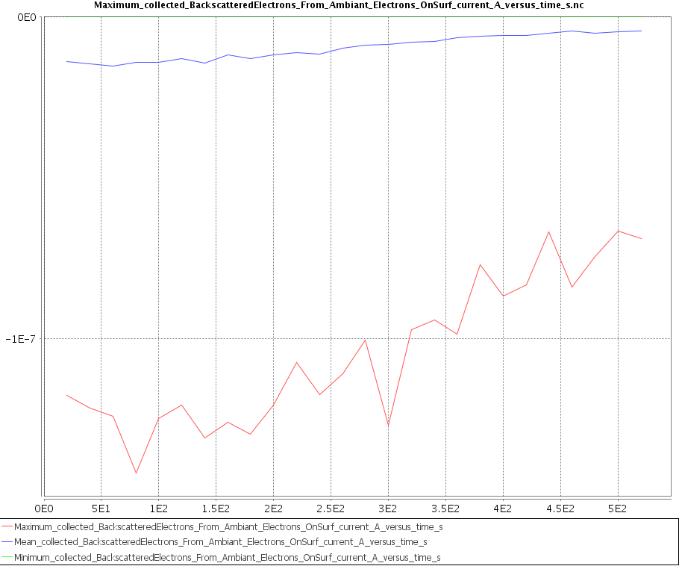
Comparison Experiment– Simulations II – Simulation set-up
Simulation with Vbus =350V.
The effect of the interconnect polarization is visible on the cover glass surface
potential. High positive potential interconnects tend to collect all electrons.

Slide 21
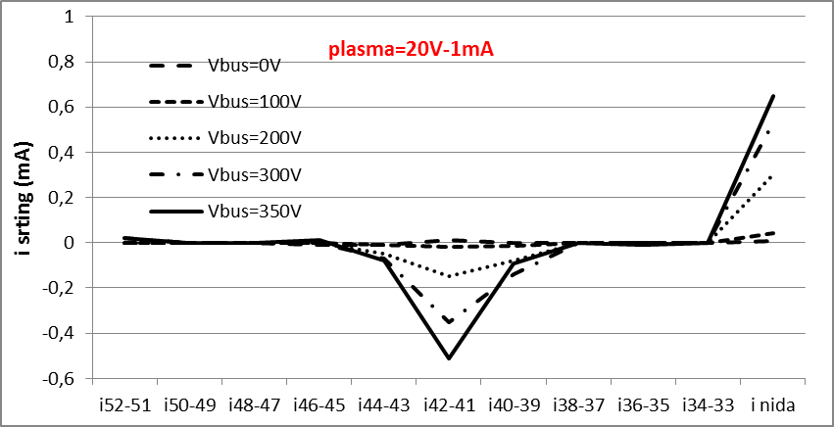
Comparison Experiment– Simulations II – Simulation set-up
Simulation with Vbus =350V.
The effect of the interconnect polarization is visible on the cover glass surface
potential. High positive potential interconnects tend to collect all electrons.

Slide 22
Perspectives (long term)
Ultimately, it would be desirable that SPIS be able to precisely compute the current collection by each unmeshed elements of the solar panel.
=> precise estimate of the power loss due to plasma recollection
including panel circuit solving, snap over effect,…
=> precise estimate of the electrostatic risks
ESD risk maps: identifies most probable ESD sites (interconnect, gaps)
possible full PIC “zoom” to better assess the risk (secondaries,...)
=> precise estimate of the erosion and ageing risks
better mapping of the eroding particle flux on each elements
better erosion models and aged material properties
ageing effect on solar cell circuit (coupling with ONERA McSOLAR code)
First step is done, but the road is long. A simplified, easy to use version of the present work should be implemented in the next version of SPIS (ESA SPIS-EP contract), but a full stable production version requires more effort.

