Slide 1
SPINE Meeting 2016
On‐going efforts toward plume‐spacecraft interaction modelling

Slide 2
Introduction
Context → All electric orbit transfer of GEO spacecraft
Analysis of electrostatic risk during the OT phase:
  Plume interaction with spacecraft:
    Plasma induced discharge
    Current collection by SA → power losses
    Spacecraft erosion and contamination
  Radiation induced effects
  Charging effects LEO/MEO/GEO plasmas
Analysis of the electrostatic risks at GEO (after OT phase)
  Change of material properties in surface due to contamination, erosion, redeposition …
  Ageing due to radiation or long term internal charging

Slide 3
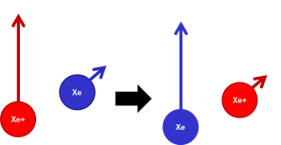
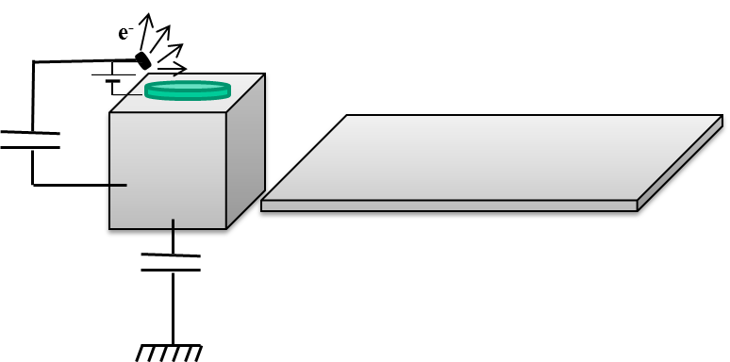
Plasma plume interaction with spacecraft
Plasma plume
  Xe+ generated and accelerated from the thruster
  e- from the cathode
  Quasi-neutral plasma
Plasma
plume
Environment
plasma
Secondary plasma
  Slow Xe+ generated by charge exchange
  Attracted by the negative potentials
CEX
plasma
Current equilibrium ? Between:
  Plasma plume
  Slow ions collected
  Environment

Slide 4
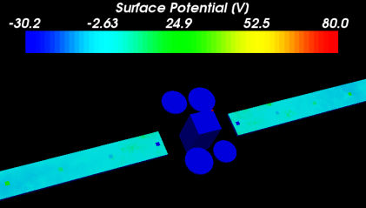
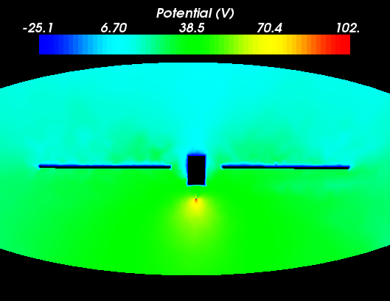
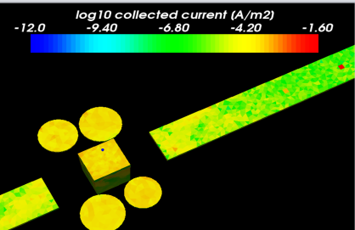
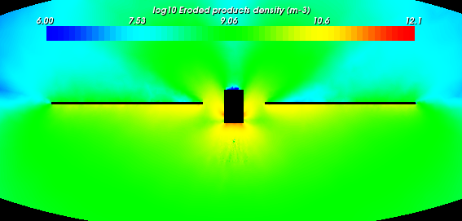
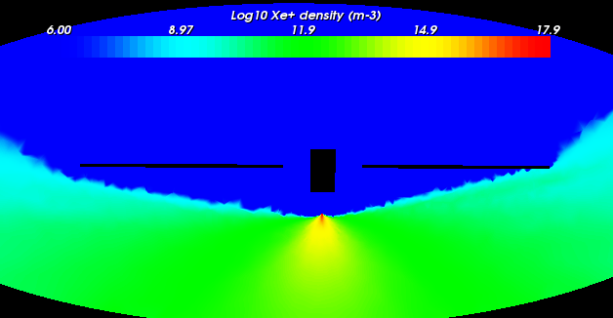
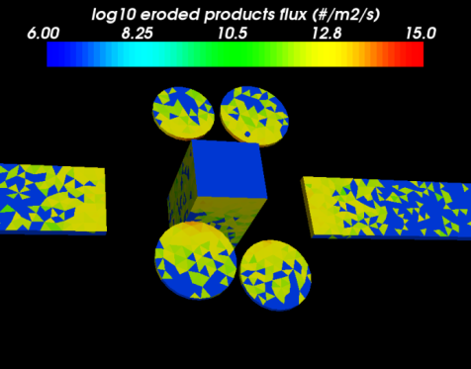
SPIS simulation principle
courtesy Stanislas Guillemant (IRAP, ONERA)
1
4
Electric field from:
Particle densities
Boundary conditions
Potential on S/C:
Current balance
RLC circuit between S/C elements
2
3
Interaction with S/C:
SEE by electrons
SEE by protons
Photo-emission
Sources
Particle Transport:
Space environment
Secondaries or
Sources from S/C

Slide 5
Models
Plasma models:
  Full PIC for all ions species Xe+, Xe2+, …, ions from environment (LEO/MEO/GEO) and CEX ions
  Fluid model for electrons: Maxwell-Boltzmann, MB truncated, polytropic, …
  Charge exchange collision between fast ions in the plume and neutrals coming from the thruster
Thruster source models:
  Standard Maxwellian sources: AxisymetricMaxwellian, MaxwellianThruster, …
  AISEPS sources: SPT100, RIT4, …
Electrostatic equilibrium:
  Current balance on the SC
  Plume potential fixed
  SC floating potential wrt plume
Effect estimated:
  Current collection by SA interconnects
  Erosion
  Contamination

Slide 6
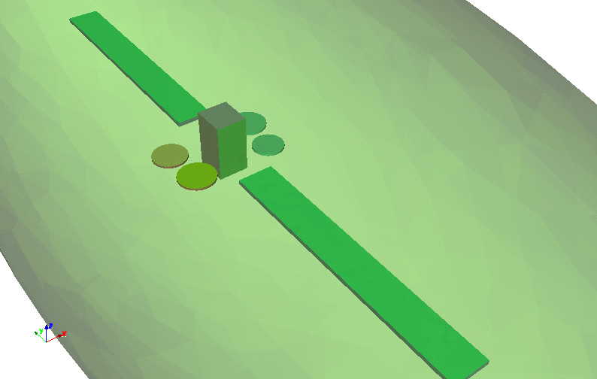
Plasma plume interaction with spacecraft
Primary plasma
Xe⁺ / 100-200 eV
N>>10¹⁶ m⁻³ / λ_{D} < 0,01mm
Geometry of a standard GEO spacecraft
Electric thruster (type SPT100) on a 1m boom (-Z direction):
  Electron and ion temp: 5 eV
  Mach number: 5 (125 eV directed –z for ions)
  Ion current: 5 A
e⁻
Secondary plasma
Xe⁺ / 20-50 eV
N<10¹⁴ m⁻³ / λ_{D} < 1mm
Environment plasma
ITO
Secondary plasma:
  generated by charge exchange between primary ions and neutrals from the thruster
Environment plasma (LEO / MEO):
  Protons at 10 eV / 10⁹ m⁻³
  Neutralized by the same population as for the thruster
CMX (+Z)
CFRP
Z
Y
X

Slide 7
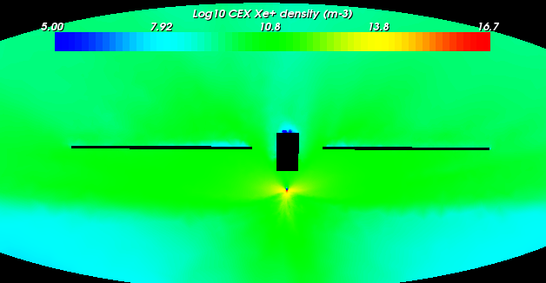
Plasma density in volume
Density of primary ions
Density of charge exchanged ions
Most of the primary ions are directed in –z → plume effect
Small amount recollected on the solar arrays
CEX ions generated in the near field of the thruster → highest density
CEX ions attracted by the negative potentials of the SC
Density almost homogeneous at 10¹¹ m⁻³ (higher than environment density)

Slide 8
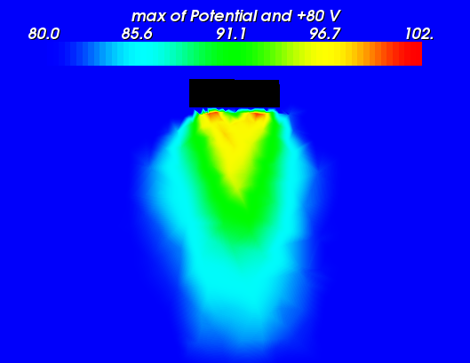
Electric potential in volume
Potentials reached at the stationary state:
  Maximum potential +102 V (larger thruster cathode +80 V)
  due to the divergence on the ion flux and the ring geometry
  On the cover glass surfaces: a floating potential between 0 V and + 35 V is reached and the
  conductive rear face of the solar array reaches a floating potential of -15.
Mean energy of the CEX ions:
  65 eV - 115 eV on the conductive parts of the spacecraft electrically connected to the spacecraft electrical mass.

Slide 9
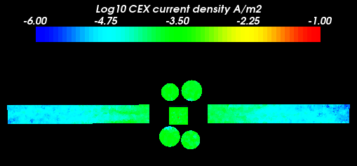
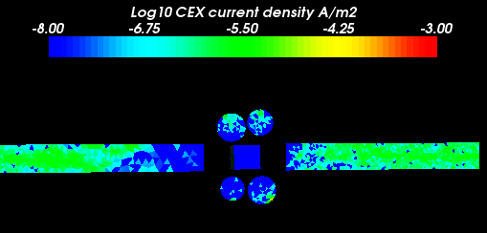
Plasma collection by the surfaces
Front face wrt thruster
Rear face wrt thruster
Front surfaces → highest current density of CEX
  from 1 mA/m² near the spacecraft body
  to 10 μA/m² at the farthest surfaces of the solar array.
Rear surfaces → very small current collection
  from 0.01 μA/m² near the spacecraft body
  to 10 μA/m² at the farthest extremity of the SA.
Current collection gradient due to volume density gradient and surface potential gradient
All the surfaces negatively charged wrt the plasma plume → all surfaces attractive for the CEX ions

Slide 10
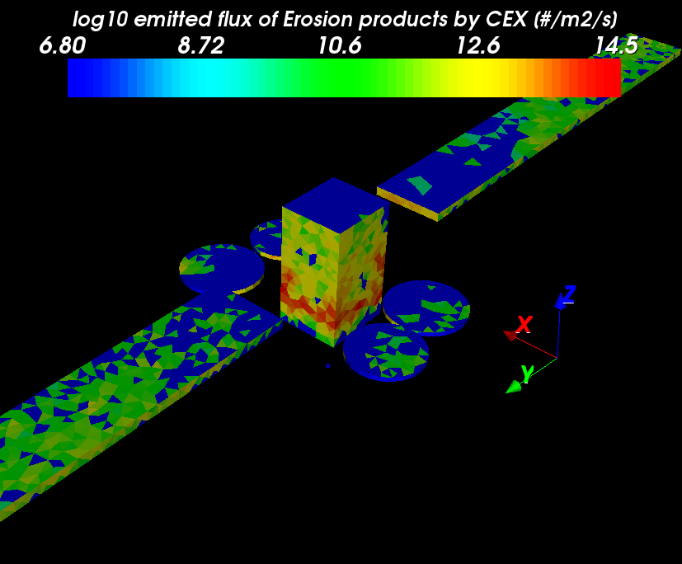
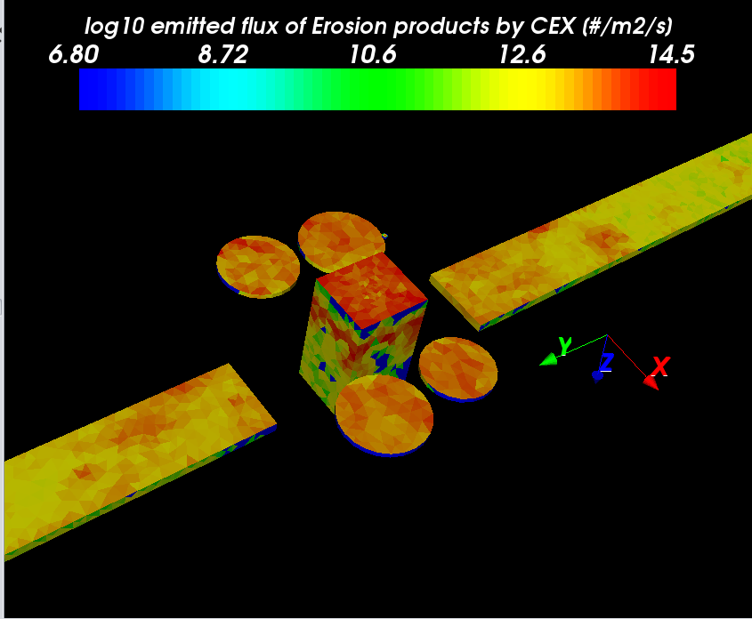

Erosion and contamination
Eroded product everywhere:
  Maximum density of eroded product is 10¹² m⁻³ → collects a lot of CEX ions because close to the thruster (about 1 m) and very negative
  On SA, density of the eroded products < 10¹¹ m⁻³
  10⁷ m⁻³ at the farthest extremity → no risk of contamination
Flux densities as large as 10¹⁵ #.m⁻².s⁻¹ collected on the front faces of the antennas, the spacecraft body lateral surfaces and on the front faces of the SA
Estimation of contaminant layer thickness:
  Taking a redeposition flux of 10¹³ #.m⁻².s⁻¹ and a mean density of the contaminant layer (a typical polymer),
  Layer deposition rate of 10⁻¹⁵ m.s⁻¹ → 1 nm layer in < 12 days of continuous operations.
  But over estimated → the erosion and evaporation of the contaminant not taken into account

Slide 11
Background → SPIS 5 heritage
SPIS-SCIENCE
ESTEC/ESA contract
Technical officer: Alain Hilgers
Consortium: ONERA, Artenum, IRF-U, IRAP
Long-term scientific program of ESA : missions dealing with plasma measurements (Solar Orbiter, Juice)
SPIS new capabilities
  Electrostatic cleanliness assessment
  SPIS adapted to relatively low energy (few eV) plasma measurements with a large number of physical models implemented
  Tested on Solar Orbiter (particle instruments), Cluster (particle & electric field), Rosetta (electric field) and Cassini (electric field)
Finalized in November 2013
Maintenance phase till September 2014
Usefull developments for EP
  Source activation
  Solar array interactors
  Live monitor: particle distribution monitor
  …

Slide 12
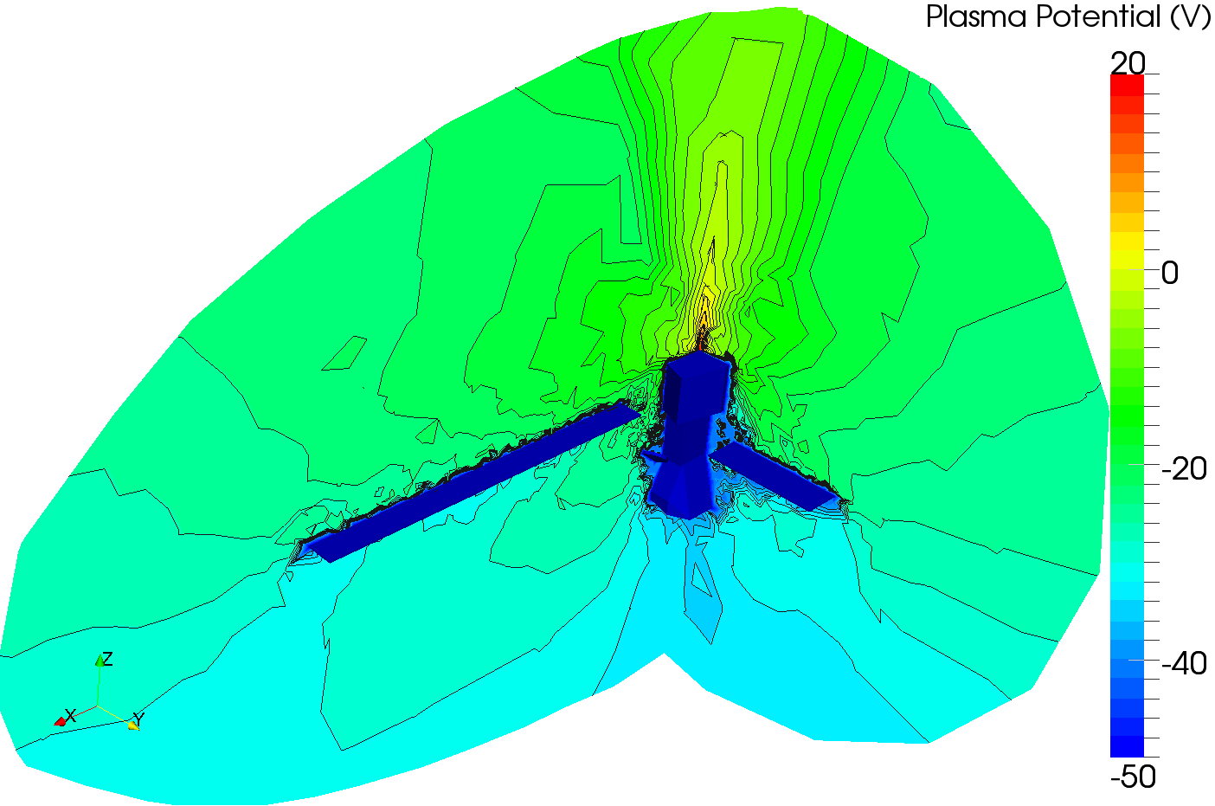
Background → SPIS 5 heritage
AISEPS
Implement in SPIS plume models for simulation of electric propulsion-spacecraft interactions
Study focus:
  Validation of plume models of SPT100, PPS1350, HEMP, RIT4, RIT10, RIT22, T5, T6, In-FEEP, Cs-FEEP thrusters
  Simulation of spacecraft charging induced by plasma plume and comparison with SMART1 in-flight data
Other study subjects
  Ground testing of RIT4: plume measurements + neutraliser behaviour under different configurations (grounded/floating)
  Dev of electronic database with lot of public plume data

Slide 13
Ongoing projects → Electron cooling
Model and Experimental validation of spacecraft-thruster Interactions (erosion) for electric propulsion thrusters plumes
Objectives:
  review of the available data and models for electrons cooling and erosion
  development and implementation of a new model of electrons cooling in SPIS
  perform on-ground tests to allow comparison with the results of the developed model
  validation of the model implemented in SPIS
→see Mario Merino presentation

Slide 14
Known limitations
Plasma models:
  MB law for electron overestimate potential gradients
  Polytropic/adiabatic laws not physical →how to extrapolate to in-flight simulation
Thruster source models:
  Neutral model to validate / improve
  Charge exchange implementation not stable / problem of performance
  Other collisions neglected (elastic collisions ….)
Electrostatic equilibrium:
  Current balance on the plume plasma not compute and not take into account for CRP calculation
  Coupling of the plasma plume with environment difficult to model
Effect estimated → to be improved
  Current collection by SA interconnects
  Erosion
  Contamination

Slide 15
Ongoing projects → SPIS-EP
Improved Modelling of Electrical Thruster Induced Plasma plume Interaction
Need for accurate modelling of the plume effects on the spacecraft
⇒ new SPIS developments that can be divided in four sub-topics:
thruster and environment definition
accurate plume modelling
electric circuit closure through the plasma
erosion and contamination
New developments must be numerically tested and physically validated
Operational use needs early user feedback and user friendly packaging.
user interface developments
with technical/scientific inputs
Numerical and physical model
developments
comparison with data and background experience
test by “external” end users
software production and dissemination

Slide 16
Time line
Start of the project: beginning of this year
Implementation end: beginning of 2017
Validation phase in 2017
First public release (beta version): end of 2017
  Includes the contribution of the both projects

Slide 17
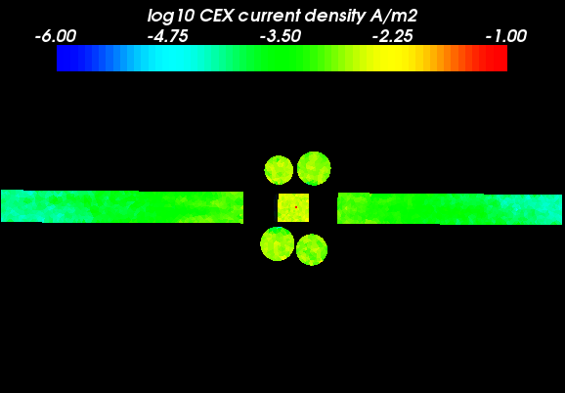
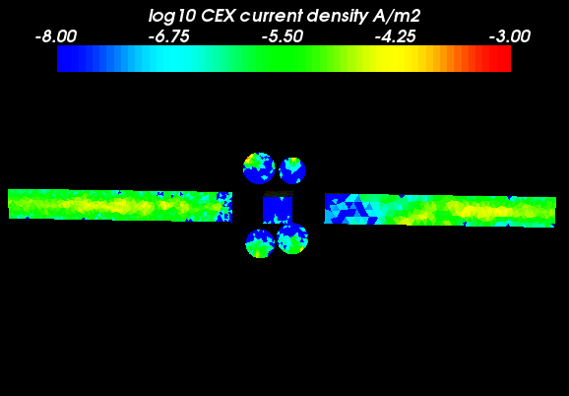
Plasma collection by the surfaces (X3 thruster flux)
Front face wrt thruster
Rear face wrt thruster
SPT100 type of thruster not sufficient for an OT of a telecom spacecraft → several higher power thruster
X3 the source flux → qualitatively the same results but the collected current X9:
  Density of primary ions X3
  Density of neutrals X3
  Thus source term of CEX X9

Slide 18
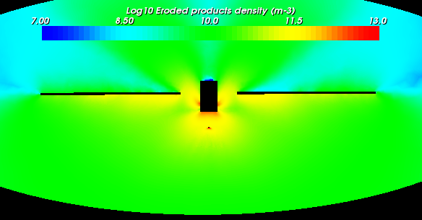
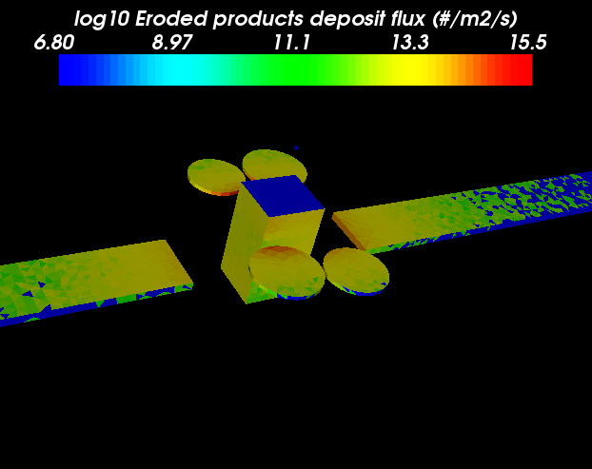
Erosion and contamination with higher power thruster
Simple SPT100 type thruster
Thruster flux X3
Increase by a factor of 3 of the thruster → increases by a factor of 3 the contamination rate
the increase of the plasma density
  → the effect of plasma contactor by the thruster more efficient
  → lower potential difference thus less ion current collection

Slide 19
Charge exchange
Xe
Xe+
Xe+
Xe

