Slide 1
SPINE Meeting 2016
Secondary electron emission model effect on the electrostatic equilbrium in GEO
Pierre Sarrailh
Mohamed Belhaj
Denis Payan

Slide 2
Overview
CNES R&T 2015 « Charging and electrostatic risks »
TO: Denis Payan (CNES)
Scope
  Surface charging (eclipse or not) greatly influenced by the secondary emission yield
  Actual SPIS (and NASCAP) models well fitted at normal incidence but angular model discrepancies wrt experiments (model efficient for very high energy >> 10 keV)
  Measurement for incidence angle > 70° very difficult on dielectrics → need to extrapolate using models
Objectives
  Definition of an angular dependent secondary electron emission yield (SEEY) model
  Effect of the angular dependence of SEEY on the charging simulation
Method
  Measurement and modeling of incidence angle effect on SEEY
  Implantation of this new model in SPIS
  Assessment of the angular effect on a SPIS simulation

Slide 3
TSEEY basics
Typical Electron emission yield (EEY*) curve shape
EEY
EEY _{max}
Mean escape depth
E_{0 max}
E₀
*Called also SEY

Slide 4
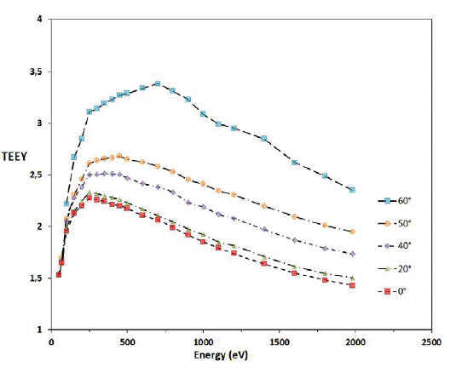
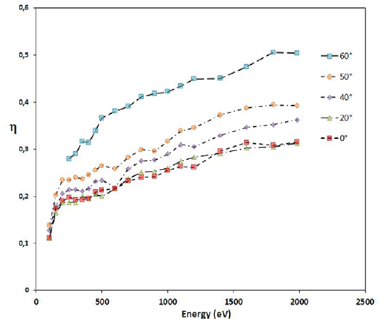
TSEY measurement
Incidence angle effect
secondary electrons yield
Backscattered electrons yield
T. Ginest et al, Meas. Sci. Technol. 25 (2014) 085601

Slide 5
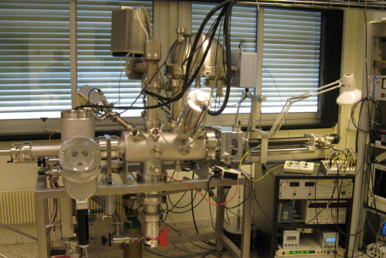
Measurement facility
Pressure 10⁻¹⁰ mbar in the analyse chamber and 10⁻⁷ mbar in the introduction chamber
3 electrons gun 1eV-2 keV, 50 eV – 5 keV and 1keV-22 keV
Ion source (25 eV -5 KeV)
Hemispherical electron energy analyser
Kr VUV lamp
Gaz analayser
Facraday cups
Electron colector
Manipulator X,Y,Z,θ
Working Temperature RT to 500°C
Incidence angle 0 to 90°
gaz analyser
Energy analyser
DEESSE
Ion gun
electron gun
@onera

Slide 6
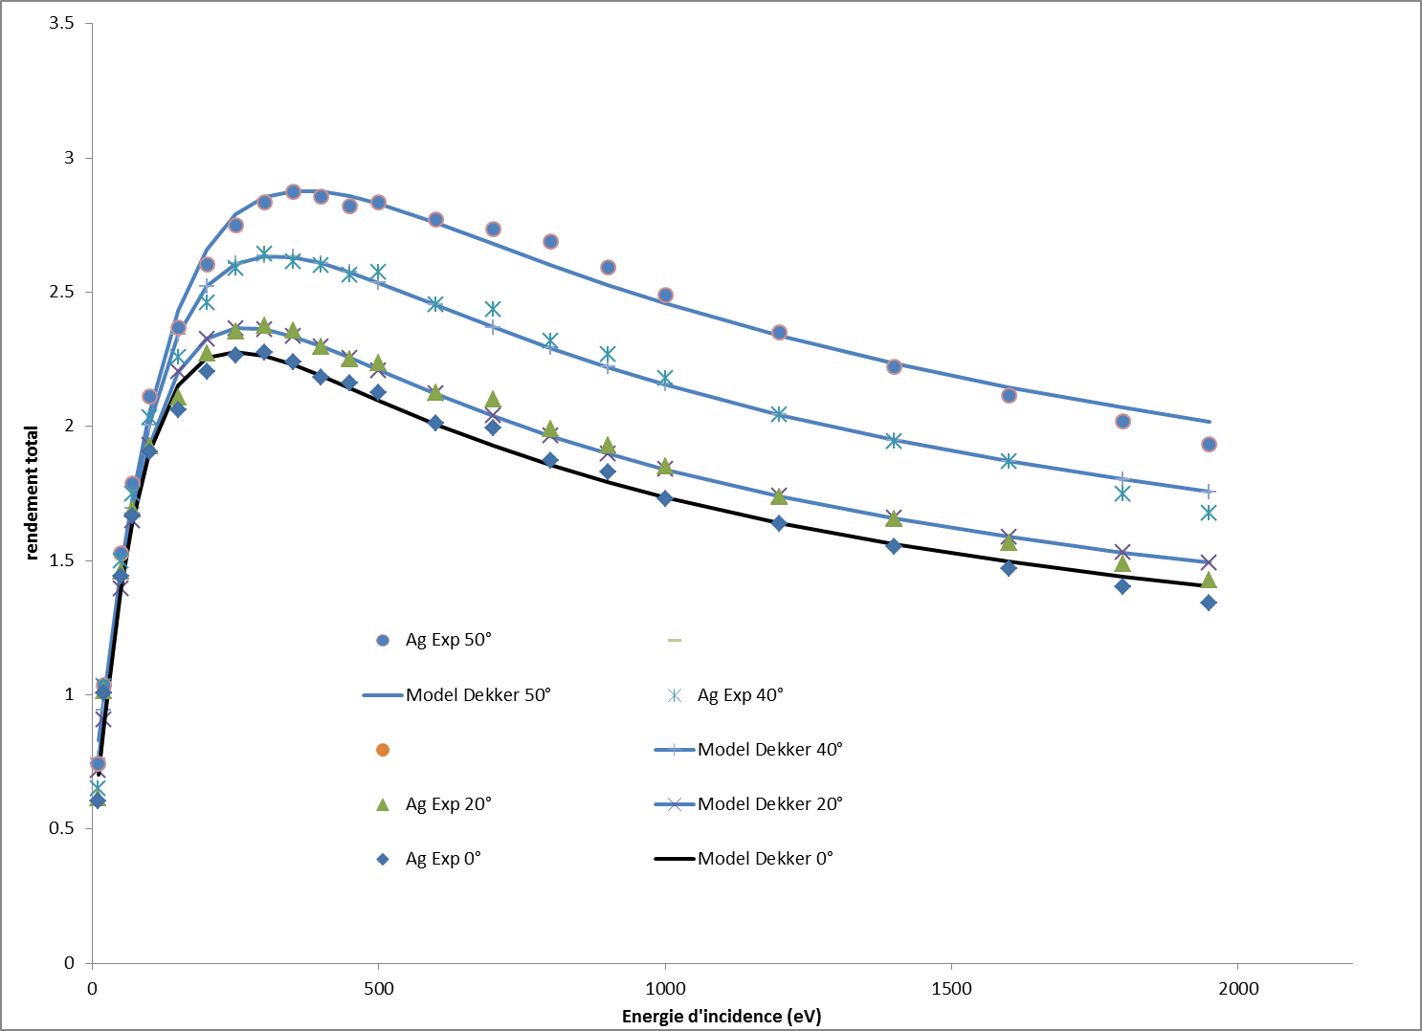
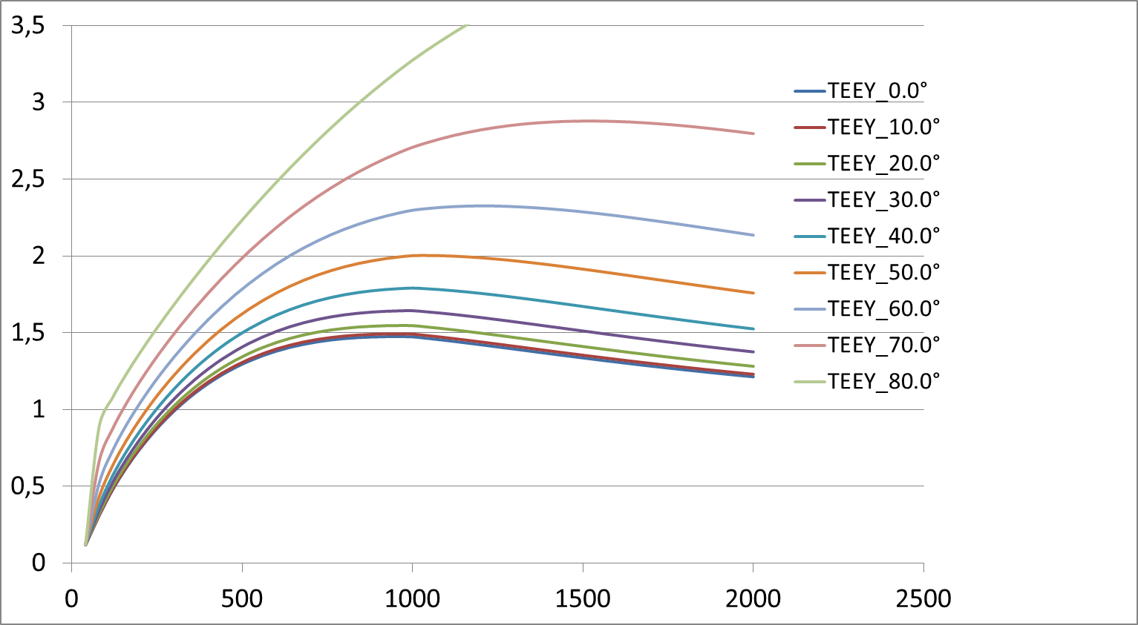
Model discrepancies (on silver)
Measurements
SPIS (and NASCAP) models
Discrepancies:
  Globally on the values
  But also on the behaviour and the waveform

Slide 7
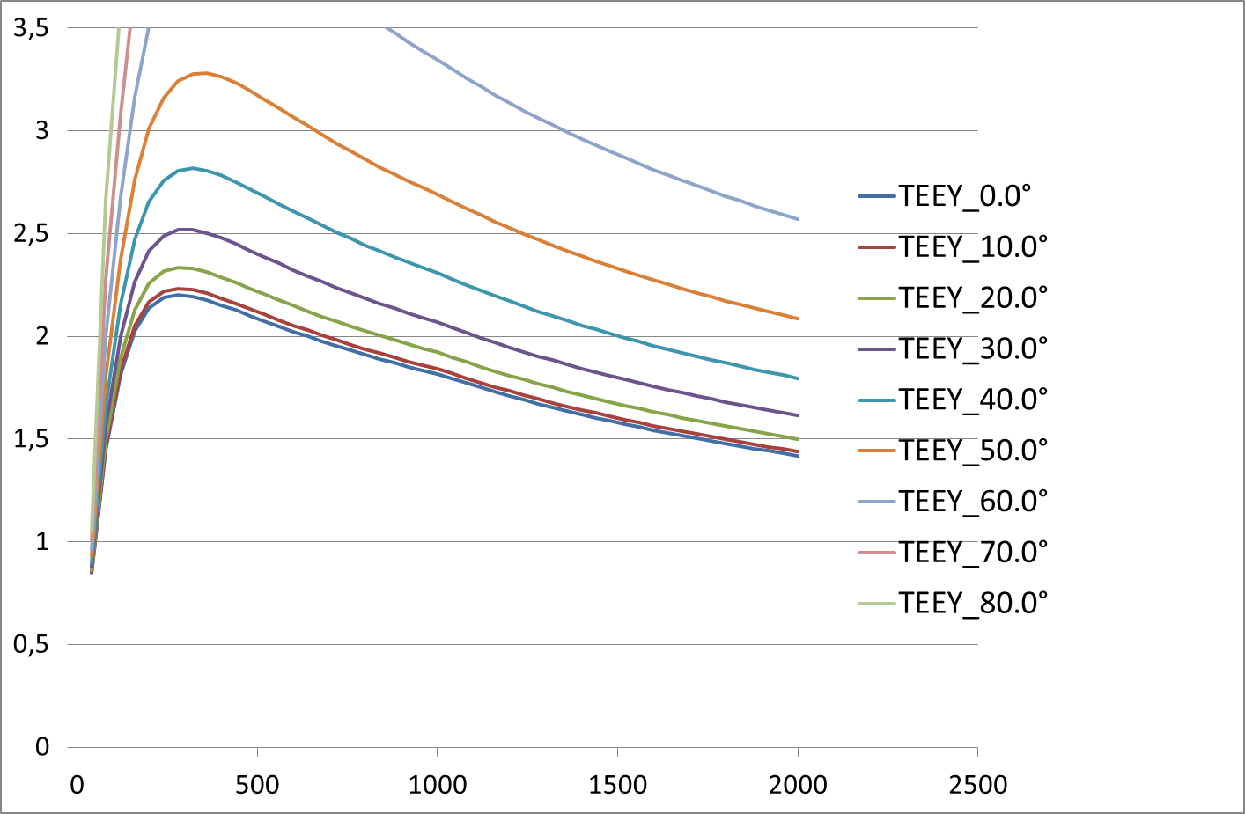
Model discrepancies (on silver)
Measurements
SPIS (and NASCAP) models
→ Fitted at normal incidence
Discrepancies:
  Globally on the values
  But also on the behavior and the waveform
  Angle effect every time overestimated

Slide 8
Dielectric measurements
Electron emission yield for dielectric samples (many possible artefacts due to the charging effect)
Incident energy > adjusted energy
Deviation of the electron beam
recollection of secondaries
Electron gun
-
+
=> apparent yield< real yield
=> apparent yield=1
Origine of chagrin
  Triboelectric effect (i.e: Teflon)
  During the measurement (charge trapping)
It is mandatory to control the charging level
(very short electron pulses, kelvin Probe, specific charge neutralization strategy)
50eV, 60°

Slide 9
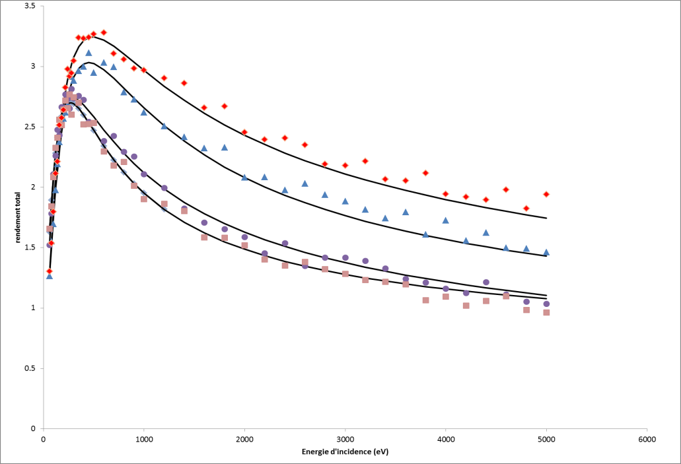
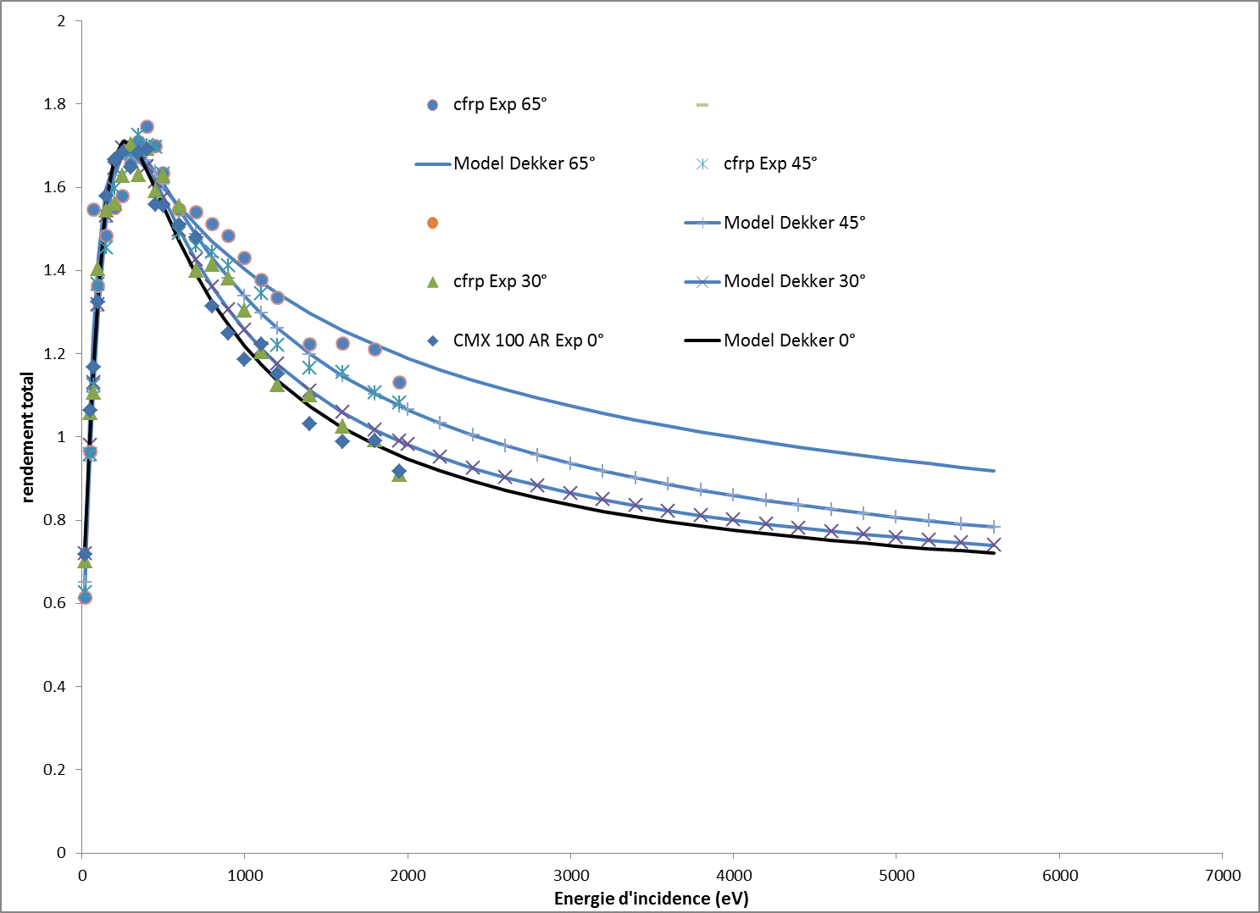
Measurement results
CMX
CFRP

Slide 10
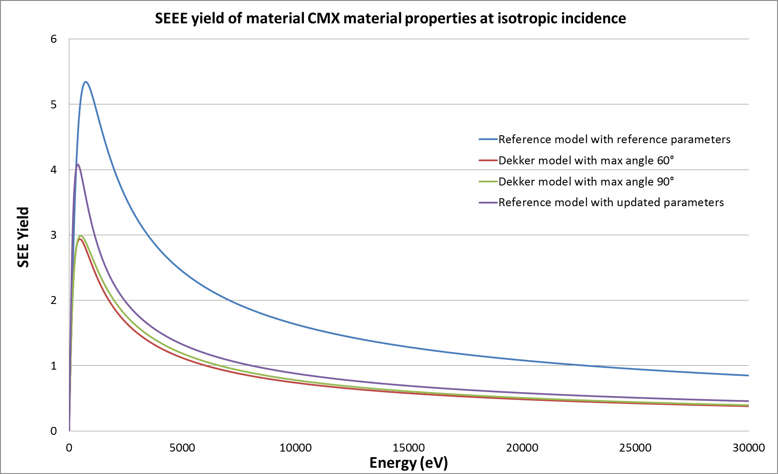
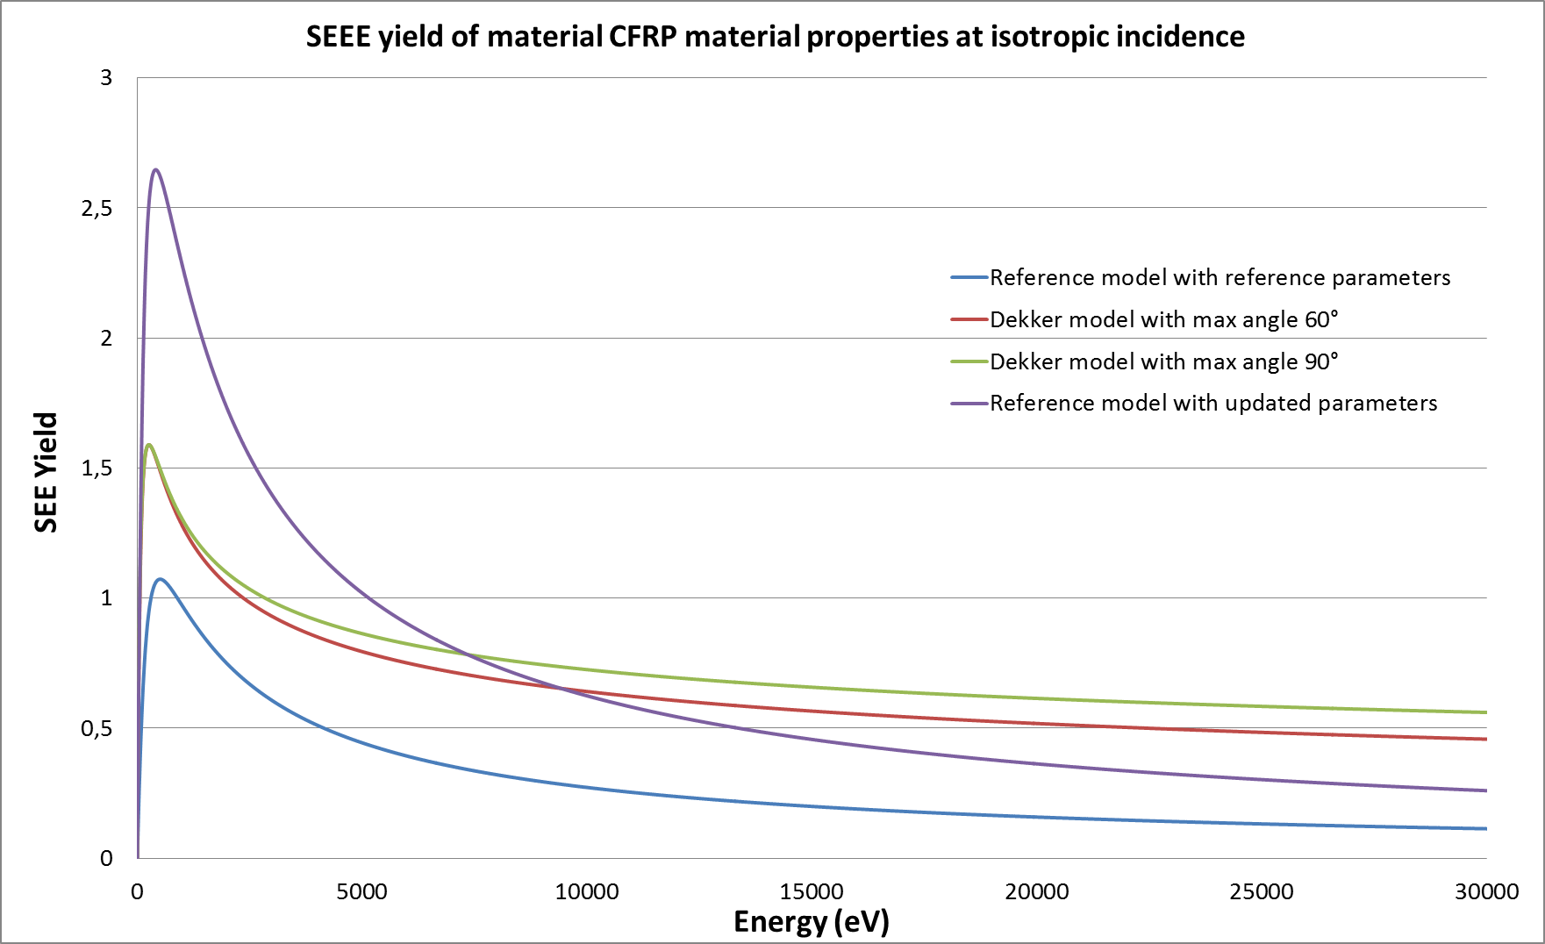
Model results for isotropic flux
CMX
CFRP

Slide 11
Electrostatic behaviour simulation
Standard GEO telecom platform
ECSS worst case environment

Slide 12
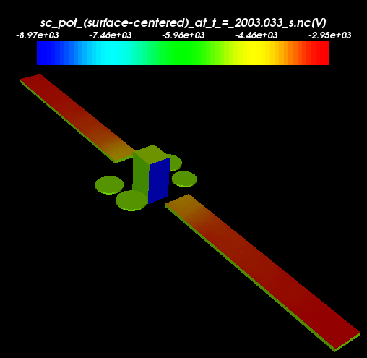
Reference simulation results
Absolute potential is -5100 V
CMX cover glasses charge positively with respect to the spacecraft ground due to strong electron emission under photon irradiation → inverted voltage gradient (IVG) situation / negative grounded conductors and positive differential voltage of dielectrics.
Maximum differential potential on solar cell cover glasses of +2100 V (> 500 V – ie ECSS)
OSR charge negatively because at shade → direct voltage gradient (DVG) / negative differential voltage of dielectrics
Secondary electron emission partly mitigates this situation
Important parameter → electric field within the thickness of the dielectrics 39 V/µm
Main ESD risk for the satellite thus comes from the solar panels.

Slide 13
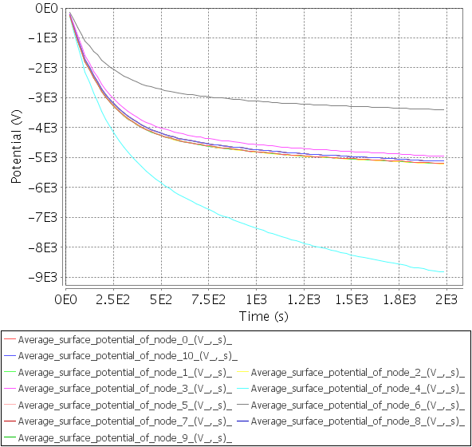
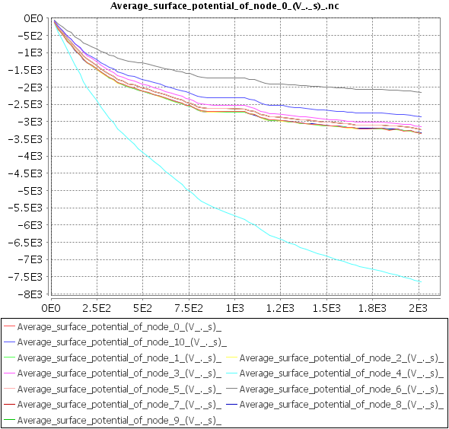
Surface potential evolution
Standard
Dekker 60
Potential (V)
Time (s)
Time (s)

Slide 14
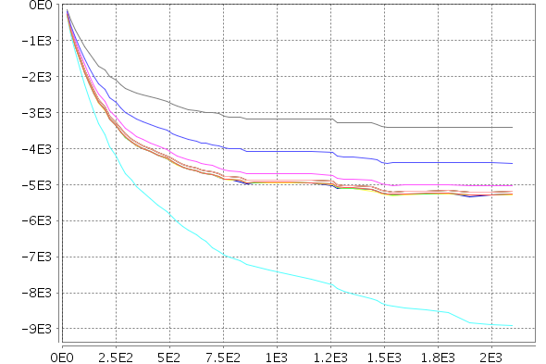
Surface potential evolution
Standard
Standard fitted
Potential (V)
Time (s)
Time (s)

Slide 15
Secondary electrons density
Standard
Dekker 60

Slide 16
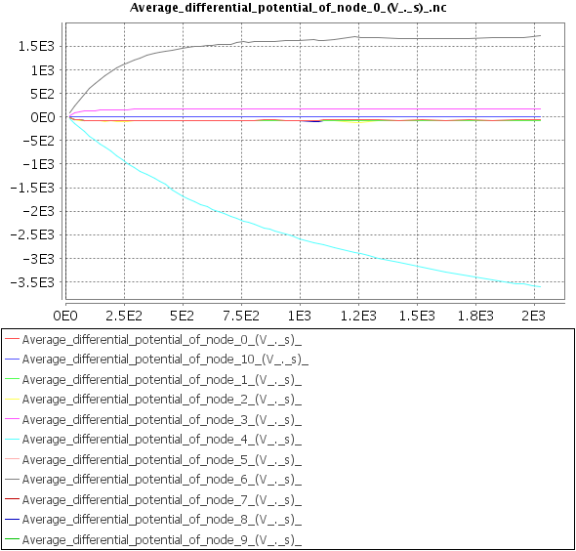
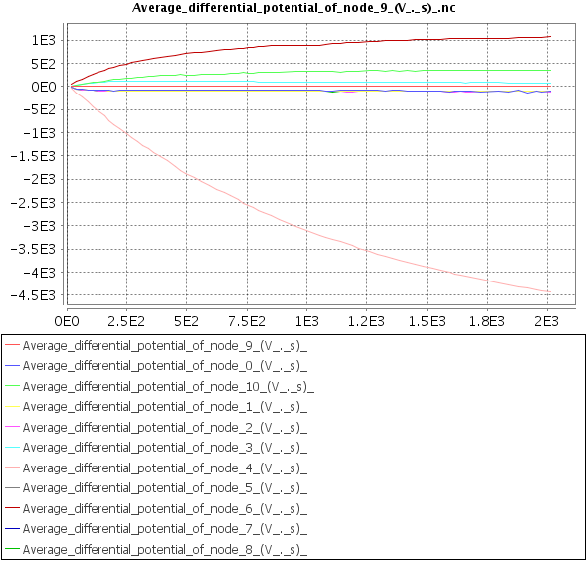
Differential potential
Standard
Dekker 60
Potential (V)
Time (s)
Time (s)

Slide 17
Conclusion
Tacking a realistic angular dependency:
  Smaller effect of angle of incidence than predict in model
  Due to surface state effect →no angular dependence at low energy
On the SC:
  Smaller emission from CMX
  Higher emission from CFRP
Smaller IVG than predicted in the standard model
 | spacecraft ground | CMX max IVG
 | kV | kV
Reference case | -5.1 | 1,6
Dekker 90 | -3.2 | 1,0
Dekker 60 | -3,7 | 1,3
Reference with updated params | -5.1 | 1,8

