Slide 1
New multi‐domain and multi‐model descriptions of the plasma species in SPIS
Oriol Jorba
Sébastien Hess , Pierre Sarrailh,
Antoine Brunet, François Rogier (ONERA)
Christophe Bastien-Thiry, Denis Payan (CNES)
Elena Serran, Michel Godefroy (LATMOS)

Slide 2
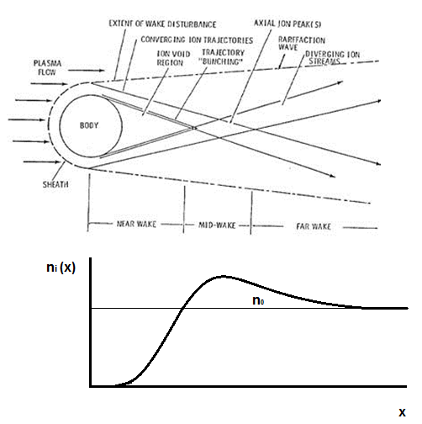
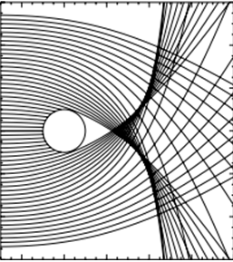
Context: Need for better performance
Some missions demands too much computational resources.
Plasma drift: PIC is needed for computing correctly the wake.
Simulate the wall effect on positive surfaces.
Need for algorithms more adapted to reduce cost or/and noise.

Slide 3
SPIS actual methods – Density (O+)
Kinetic model (PIC)
Fluid model (Poisson-Boltzmann)
Densité Ionique (O+)
Densité Ionique (O+)
Physically accurate
Very computationally intensive (18h)
Not always accurate:
Thermal equilibrium & isotropy
Very fast (157 seconds)
Notes:
Les méthodes actuelles qu’on peut utiliser sur SPIS sont les suivants:
Une modèle particulaire, concrètement PIC – de Particle-In-Cell, qui est physiquement exact car est capable de bien modéliser le sillage ionique et de microinstabilities sur le plasma. Par contre, cette méthode c’est très coûteux.
En suite SPIS a aussi une méthode fluide, appelé méthode Poisson-Boltzmann, lequel est pas représentatif de la réalité mais par contre est très rapide, environ 2-3 min par rapport à 18h pour modéliser TARANIS.

Slide 4
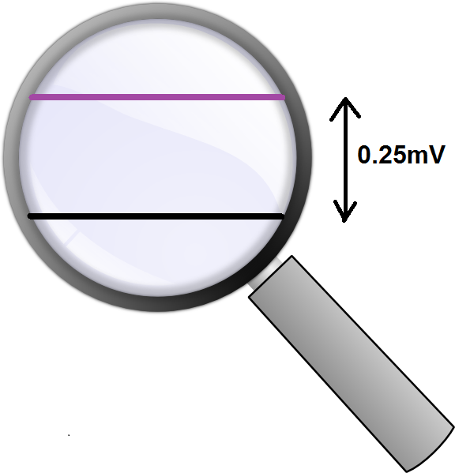
SPIS actual methods – Surface potentials
PIC model
(18h)
Poisson-Boltzmann model
(157 seconds)
Solar panels
Solar Panels
S/C
S/C
IME-BF 1
IME-BF 1
IME-BF 2
IME-BF 2
High statistical noise
No statistical noise
Notes:
En suite, on peut voir le potentiel de surface en fonction du temps du TARANIS. La ligne bleu c’est le potentiel diélectrique, notamment du scotch Kapton, la ligne roige est le potentiel du satellite, alors que les autres deux sont le potentiels sur les deux capteurs IME-BF. On observe que la méthode PIC à une bruit statistique très élevé alors que la méthode fluide n’a pas de tout du bruit statistique, ce qui fait possible mesurer de différences de potentiels très basses.

Slide 5
SPIS: Schema
$φ_{n}, E_{n}$ in each cell
Motion equations
Fluid distribution update
Particle motion
or
Poisson equation
Computation of moments in each cell (density, current…)
Notes:
.

Slide 6
PIC statistical noise
PIC algorithms generate too much noise for some applications: Scientific missions
Need for noiseless* methods
Coupled method
PIC - $δf$
perturbative method
*Reduced computational cost vs noise ratio

Slide 7
Coupled Method
The distribution function is a Local Maxwellian:
$$f\left(x,v,t\right)=n_{0}(x){\left(\frac{m}{2πkT(x)}\right)}^{−3/2}e^{−\left(\frac{m{\left(v−v_{0}\left(x\right)\right)}^{2}+qφ(x,t)}{kT(x)}\right)}$$
Where $n_{0}\left(x\right), v_{0}\left(x\right)$ and $T\left(x\right)$ are computed initially ($t_{0}=0$) using a kinetic distribution having $φ\left(x, t_{0}\right)=0$.
Kinetic distribution: No coupling with the Maxwell equations:
We can use a bigger time step.
Noise severely reduced (there is no perturbations).
$T(x):$we should use a huge amount of particles for having a good approximation.

Slide 8
Coupled Method (II): Schema
$φ_{n}, E_{n}$ in each cell
Motion equations
If ($t=t_{0}$)
Fluid distribution update
Particle motion
and
Poisson equation
Fluid moment update
Computation of moments in each cell (density, current…)
Notes:
.

Slide 9
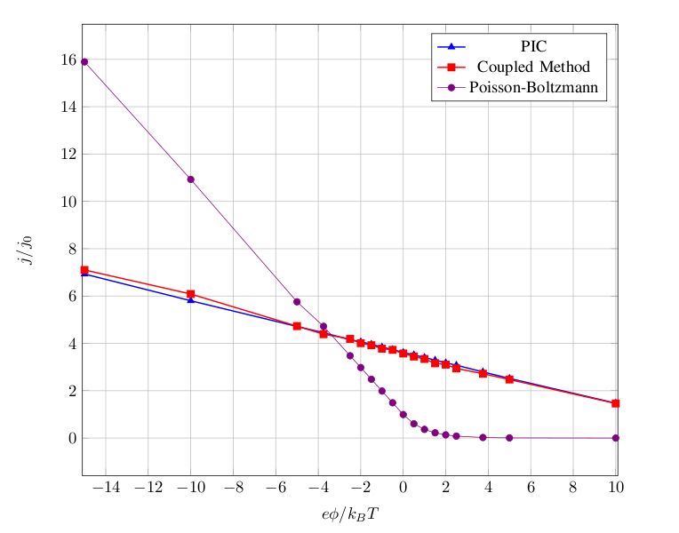
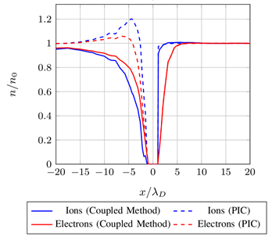
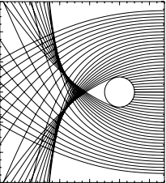
Coupled Method (III) – Ion current validation
Validation: Sphere ($R=2 cm)$immersed in an ionospheric plasma with a drift velocity $V_{d}≈4V_{th}$
Coupled method
PIC method
Ion total collected current for different polarized potentials.
Ion and electron density for a floating probe.
The Coupled Method gives a good approximation for the ion collected current.
But… it can’t compute correctly the wake density.

Slide 10
Coupled Method (IV) – TARANIS calculation
Panneaux Solaires
Satellite
IME-BF 1
IME-BF 2
No noise
Potential and collected current
Wake characterization
Coupled Method
(12 min)

Slide 11
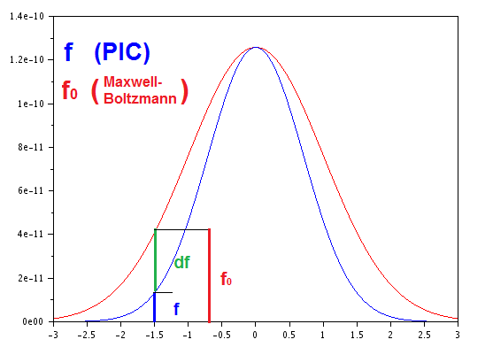
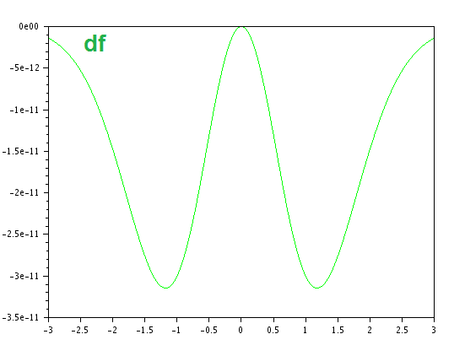
$δf$–PIC method (I): Perturbative method
$$f= f_{0}+δf$$
Where $f_{0}$ is an analytical known distribution function.
$$\frac{df}{dt}=0 → \frac{dδf}{dt}= −\frac{df_{0}}{dt}$$
$δf$-PIC:
$$ω\left(x,v,t\right)= \frac{δf}{f} → \frac{dω}{dt}=−(1−ω)\frac{1}{f_{0}}\frac{df_{0}}{dt}$$
$δf$-PIC statistical noise: $\sim \frac{1}{\sqrt{N_{p}}}\left\langle \frac{δf}{f}\right\rangle$
« 7th motion equation in a 3D-PIC schema »
Notes:
.

Slide 12
$δf$–PIC method (II): Schema
$φ_{n}, E_{n}$ in each cell
$δf$-PIC
$$f_{0}$$
Motion equations
Fluid distribution update
Particle motion
and
Poisson equation
Fluid moment upload
$δf$ weight
Computation of moments in each cell (density, current…)
Notes:
.

Slide 13
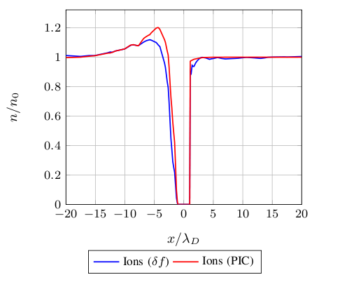
$δf$–PIC method (III): Results
$δf$ density (log)
The $δf$ method* allows to compute the rear wake correctly
*Is not yet fully implemented in SPIS (only for the Maxwellian distribution function) : $\frac{1}{f_{0}}\frac{df_{0}}{dt}≈{−2∙v}_{1}\frac{q}{m}E/{v_{th}}^{2}$
Notes:
.

Slide 14
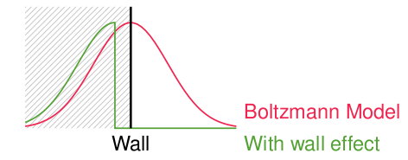
Surface effect correction: Positively biased S/C
Objective: Correct plasma behavior near satellite surfaces while using a fluid description.
Most significant effect: Non-symmetry of the velocity distribution near satellite surfaces.
$$v≥−\sqrt{\frac{2eφ_{sc}}{m}}$$
Idea: Use a $δf$ like method to compute a correct distribution.
SPIS implementation: PIC electron Maxwellian source with a negative weight on every satellite surface.
Notes:
.

Slide 15
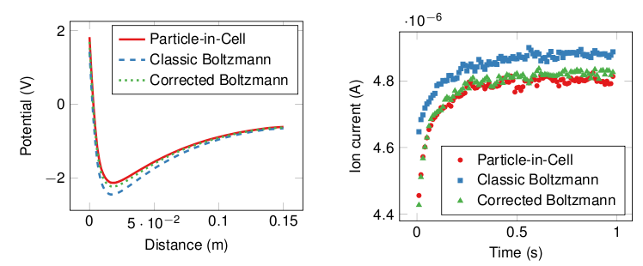
Surface effect correction: Results
Potential profile on the normal to the spacecraft surface
Total collected ion current on the spacecraft
Notes:
.

Slide 16
Thank you for your attention

Slide 17
$δf$–PIC method (II): Schema
Computation of the electric field and electric potential $φ_{n}, E_{n}$ in each cell
Motion equations
Computation of all new positions and velocities: ${x^{p}}_{n+1}$, ${v^{p}}_{n+1}$for all particles $p$
Poisson equation
Computation of the distribution function
${{f_{0}^{}(x}^{p}}_{n+1}$, ${v^{p}}_{n+1})$ for all particles $p$
$δf$
Computation of all new weights $ω_{n+1}$ for all particles $p$
Computation of the density and current density $n_{n+1}, j_{n+1}$ in each cell.
Notes:
.

