Slide 1


15 years of LANL data compared to ECSS guidelines for surface charging
23rd SPINE meeting
April 4th, 2017, ESA HQ, Paris
J.C. Mateo-Velez ⁽¹⁾, A. Sicard⁽¹⁾, D. Payan⁽²⁾
(1)
(2)

Slide 2
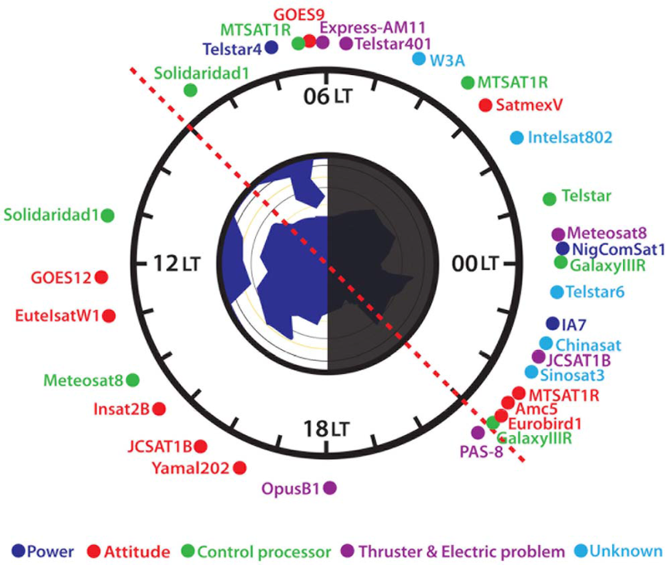
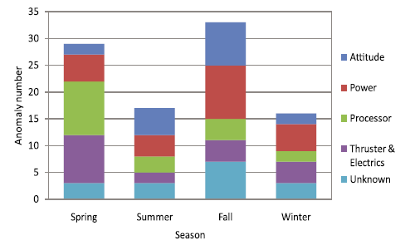
Context
From Choi 2011, electron < 100 keV seem to have similar behaviors with spacecraft anomalies 1997-2009
  95 anomalies from Satellite News Digest
  32 anomalies with known times: 72 % (23/32) in night sector, with high kp index, correlation with 50-75 keV e⁻
  Seasonal effects: increased kp and eclipse situations during equinox seasons
  Probable cause for anomalies = surface charging by electron injection in the geomagnetic tail causing electrostatic discharges (ESD)
Choi et al. 2011

Slide 3
Context
At spacecraft design phase, the risk assessment combines two approaches
  Surface charging risk is generally assessed at spacecraft scale by using computational tools (SPIS, NASCAP, MUSCAT, etc.)
  Threshold and effects of ESDs assessed by testing in order to limit/avoid power losses on solar cells for instance
Knowing the ‘severe’ and ‘extreme’ environments at GEO/MEO is of prime importance
    Worst-case environments from guidelines (ECSS, NASA) defined in the 80’s
    More recent data can be used to check that guidelines remain conservative and/or to propose new environment specifications
  Objectives
    Analyse 15 years of data on LANL spacecraft at GEO
    Investigate possible correlation with anomalies from Choi 2011
    Compare with guidelines

Slide 4
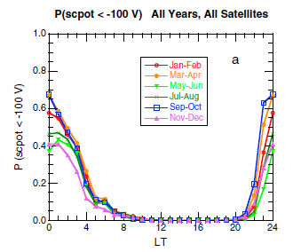
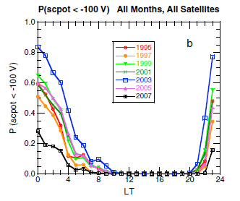
LANL data
Analysis of 7 GEO LANL satellites data
  1989-049, 1990-095, 1991-080, 1994-084, LANL-97A, LANL-01A, LANL-02A: > 60 satellites-years
  Electron and proton detectors from 1 keV up to some MeV
Thomsen-2013 analyzed 13 years of data from 1995 to 2007
  Large negative potential (< -100 V) seen during geomagnetically active times, in the region surrounding midnight local time
  Increased probability in the declining phase of the solar cycle 2003-2004
  Increased probability in equinox seasons (march-april; sept-oct)
  Best correlation with 8 keV electron flux if threshold of 1.4×10³ cm⁻².s⁻¹.sr⁻¹.eV⁻¹ is exceeded
  Same statistical dependence as anomalies from Choi-2011
Thomsen et al. 2013

Slide 5
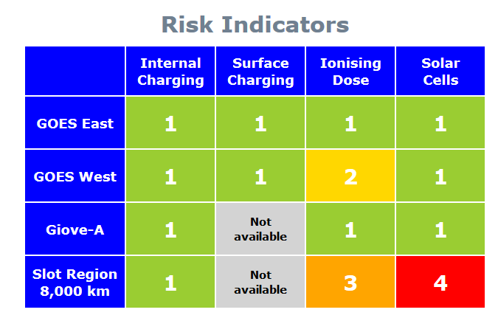
LANL data
15 years of data from 1989 to 2005 : additional statistical information
  Electron and proton spectra corrected by the spacecraft potential : eg. 8 keV electron measured by -2 kV spacecraft mean that initial electron energy was 10 keV
  Electron spectra binned in 10-50 keV, 50-100 keV, 100-200 keV ranges
  Best correlation of potentials with 10-50 keV (consistent with Thomsen-2013). Probability to get a voltage below -1000 V is
    20 % if 10-50 keV electron flux exceeds 2 ×10⁸ cm⁻².s⁻¹.sr⁻¹ (0.01 % of the time)
    10 % if 10-50 keV electron flux is 1-2 ×10⁸ cm⁻².s⁻¹.sr⁻¹ (1 % of the time)
    1 % if 10-50 keV electron flux is 0.4-1 ×10⁸ cm⁻².s⁻¹.sr⁻¹ (10 % of the time)
  Used in Spacestorm Satellite Risk Indicators webpage http://www.risk.spacestorm.eu/

Slide 6
‘Severe’ LANL environments
Maximum electron fluxes above 10 keV [FE10k]
  Averaged over 15 minutes; declustering by selection of maximum flux each month on each spacecraft (>600 events); selection of top 100 events over all spacecraft-month
  8 keV electron flux > 4×10³ cm⁻².s⁻¹.sr⁻¹.eV⁻¹ (exceed Thomsen-2013 threshold)
Top events
April 5th 2004
July 15th, 2000
Oct 29th, 2003
  Solar-cycle dependence : least probability during solar minimum (1996),
  more probable during declining phase (1992-1993; 2003-2004)
  Spacecraft potential < -100 V down to -1500 V
  Geomagnetic activity dependence: kp index greater than 4 and up to 9
  MLT dependence: 9 PM - 6 AM night sector
  Unclear seasonal effect
Related anomalies ?
July 30th, 1999 (ANIK E2, tmp outage)
Sept 12th, 1999 (PAS-8, tmp outage)
Oct 28th, 2003 (Kodama, tmp safe mode)
Jan 17th, 2005 (JCSat1B, tmp outage)
Sept 14th, 2005 (Koreasat 2, tmp outage)

Slide 7
‘Severe’ LANL environments
Top event
March 13th, 1997
Long durations with potential < -5000 V [PG5k]
  8 keV electron flux > 3×10³ cm⁻².s⁻¹.sr⁻¹.eV⁻¹ (exceeds Thomsen-2013 threshold)
  Solar-cycle dependence : more probable during declining phase (1992-1993; 2003-2004)
  Geomagnetic activity dependence: kp index between 2 and 6
  MLT dependence: midnight
  Seasonal effect: equinoxes (march-april; sept-oct) → high probability in eclipse
  High negative charging exceeds the eclipse duration from times to times
Related Anomalies ?
March 17th, 2004 (PAS-6, pow er anomaly)
Sept 19th, 2003 (Telstar 4, total loss)

Slide 8
‘Severe’ LANL environments
High flux above 200 keV and medium flux below 50 keV [HFAE]
  Solar-cycle dependence : less probable during solar minimum (1996), more probable during declining phase (1992-1993; 2003-2004)
  8 keV electron flux > 2×10³ cm⁻².s⁻¹.sr⁻¹.eV⁻¹ (exceeds Thomsen-2013 threshold)
  Geomagnetic activity dependence: kp index between 3 and 8
Top events
May 29th, 2003
July 15th, 2000
Oct 29th, 2003
  MLT dependence: 09 PM – 09 AM night sector
  No seasonal effect
  High negative charging down to -5000 V in eclipse from times to times
Related Anomalies ?
Jan 11th, 1997 (Telstar 401, ESD, total loss) Aug. 27th, 2000 (Solidaridad 1, total loss)
Sept 19th, 2003 (Telstar 4, total loss) April 5th, 2005 (Garuda 1, pow loss)

Slide 9
‘Severe’ LANL environments
Low flux above 200 keV and high flux below 50 keV [LFHE]
  Solar-cycle dependence : no clear dependence
  8 keV electron flux > 6×10³ cm⁻².s⁻¹.sr⁻¹.eV⁻¹ (exceeds Thomsen-2013 threshold)
  Geomagnetic activity dependence: kp index between 3 and 8
Top event
Sept 9th, 1997
  MLT dependence: 09 PM – 09 AM night sector
  Least probability in solstice (june, dec)
  High negative charging down to -5000 V in eclipse from times to times
Related Anomalies ?
Sept 1st, 1998 (Sirius 2, loss of some solar cells) Oct 23rd, 2001 (Echostar VI, loss of 2 strings)

Slide 10
‘Severe’ LANL environments
LANL top events have been fitted by tri-maxwellian distributions
Date | loc. | Ref | Electron 1 |  |  | Electron 2 |  |  | Electron 3 |  |  | Proton 1 |  |  | Proton 2 |  |  | Proton 3
 |  |  | N (10⁶/m³) | T (keV) |  | N (10⁶/m³) | T (keV) |  | N (10⁶/m³) | T (keV) |  | N (10⁶/m³) | T (keV) |  | N (10⁶/m³) | T (keV) |  | N (10⁶/m³) | T (keV)
April 05, 2004 | GEO | LANL FE10k N°1 | 0.6 | 1 |  | 0.7 | 7 |  | 0.1 | 15 |  | 0.1 | 0.7 |  | 1 | 15 |  | 0.01 | 40
May 29, 2003 | GEO | LANL HFAE N°1 | 0.05 | 1 |  | 0.2 | 5 |  | 0.25 | 20 |  | 0.2 | 2 |  | 0.35 | 15 |  | 0.15 | 40
Sept 03, 1997 | GEO | LANL LFHE N°1 | 0.25 | 1 |  | 1 | 5 |  | 0.05 | 10 |  | 0.2 | 1 |  | 1.1 | 15 |  | 0.007 | 40
March 13, 1997 | GEO | LANL PG5k N°1 | 0.4 | 5 |  | 0.1 | 10 |  | 0.004 | 30 |  | 0.03 | 2 |  | 0.5 | 12 |  | 0.005 | 40
July 15, 2000 | GEO | LANL FE10k_05min N°3 | 0.1 | 3 |  | 0.5 | 10 |  | 0.2 | 25 |  | 0.15 | 1 |  | 0.4 | 10 |  | 0.4 | 50
October 29, 2003 | GEO | LANL FE10k_05min N°5 | 1 | 3 |  | 0.1 | 10 |  | 0.28 | 20 |  | 0.1 | 1 |  | 0.3 | 10 |  | 0.35 | 40

Slide 11
‘Severe’ LANL environments and guidelines
ECSS Guidelines from event on SCATHA April 24th, 1979
  Two-maxwellian distribution that exceeded the actual data above 20 keV
  Tri-maxwellian distribution is suggested to mimick the actual data
electrons
protons
NASA guideline
  Simple maxwellian for the 90th percentile GEO flux
  Alternative worst-case to be discussed with US people because of some uncertainties on so-called SCATHA-Mullen-1 and 2 (to be discussed with HB Garrett and D Ferguson)
  ATS-6

Slide 12
‘Severe’ LANL environments and guidelines
LANL envelope
Guidelines envelope
LANL Vs. Guidelines
LANL Vs. Suggested updated worst-cases
(incl. from HB Garrett)
Guidelines electron fluxes are significantly higher above 20 keV, and a bit weaker below 5 keV
Suggested cases better fit with LANL data
LANL fluxes are exceeded in [10-100 keV]

Slide 13
SPIS simulations
Assess telecom spacecraft charging under severe environments
  Absolute potential and Inverted Potential Gradient (IPG) of solar panels
  At daylight and in eclipse
frame
IPG on solar panels
Mateo-Velez, Theillaumas et al. 2015
Spacecraft materials from SPIS default database with additional information from ONERA on properties measurements for CMX, MLI

Slide 14
Worst-case charging at Sun
Origin | Title | Absolute potential (V) |  |  |  |  | Differential potential (V)
 |  | Frame | CMX av. | CMX max | diel min |  | CMX | CMX max | diel min
NASA-HDBK-4002A | SCATHA-Mullen-1 | -12100 |  | -7100 |  |  |  | +5000
NASA-HDBK-4002A | SCATHA-Mullen-2 | -7800 |  | -4500 |  |  |  | +3300
NASA-HDBK-4002A | Deutsch ATS-6 | -3600 | -2400 | -2000 | -5600 |  | +2200 | +2600 | -2000
ECSS‐E‐ST‐10‐04C | SCATHA April 24, 1979 | -5000 | -3300 | -2600 | -8600 |  | +1700 | +2400 | -3600
NASA-HDBK-4002A | 90th percentile | -2300 |  | -1200 |  |  |  | +1100
‘ECSS‐E‐ST‐10‐04C’ | SCATHA April 24, 1979 Suggested modification | -2200 | -1400 | -1200 | -2500 |  | +800 | +1000 | -300
‘NASA-HDBK-4002A’ | SCATHA-Mullen-2 cor by HBG | -880 | -530 | -440 | -1200 |  | +350 | +440 | -320
LANL-ONERA-CNES | FE10k – HFAE – LFHE – PG5k |  |  |  |  |  |  | +200 to +300
‘NASA-HDBK-4002A’ | SCATHA-Mullen-1 cor by HBG | -380 | -220 | -200 | -620 |  | +160 | +180 | -240
?
?
at daylight
Photoemission limits negative charging, prevent charging of fully conductive spacecraft
Charging is made possible by covering insulators on sunlit surfaces
Electron fluxes above 10-20 keV control the absolute spacecraft charging
Photoemission results in high IPG level on solar arrays

Slide 15
Worst-case charging in eclipse
Origin | Title | Absolute potential (V) |  |  |  |  | Differential potential (V)
 |  | Frame | CMX av. | CMX max | diel min |  | CMX | CMX max | diel min
‘ECSS‐E‐ST‐10‐04C’ | SCATHA April 24, 1979 Suggested modification | -6100 | -4100 | -3700 | -6400 |  | +2000 | +2400 | -300
NASA-HDBK-4002A | SCATHA-Mullen-1 | -24000 | -22000 | -21900 | -24700 |  | +2000 | +2100 | -700
ECSS‐E‐ST‐10‐04C | SCATHA April 24, 1979 | -11300 | -9500 | -9400 | -12000 |  | +1800 | +1900 | -700
NASA-HDBK-4002A | SCATHA-Mullen-2 | -18400 | -16800 | -16600 | -18900 |  | +1600 | +1800 | -500
‘NASA-HDBK-4002A’ | SCATHA-Mullen-2 cor by HBG | -3700 | -2450 | -2200 | -3900 |  | +1250 | +1500 | -200
LANL FE10k N°1 | April 5th, 2004 | -2350 | -1550 | -1370 | -2550 |  | +800 | +980 | -200
‘NASA-HDBK-4002A’ | SCATHA-Mullen-1 cor by HBG | -2200 | -1450 | -1300 | -2350 |  | +750 | +900 | -150
LANL HFAE N°1 | May 29th, 2003 | -4500 | -3700 | -3700 | -4500 |  | +800 | +800 | 0
NASA-HDBK-4002A | 90th percentile | -16500 | -15900 | -15800 | -16700 |  | +600 | +700 | -200
NASA-HDBK-4002A | Deutsch ATS-6 | -25700 | -25100 | -25100 | -25900 |  | +600 | +600 | -200
?
?
In eclipse
Electron above 10 keV control the absolute spacecraft charging
Electron below 10 keV generates secondary emission
Electron below 10 keV generates high IPG level on solar arrays
→ Different worst-cases

Slide 16
Conclusion
SCATHA experienced a very severe event on April 24th, 1979 that remains above 15 years of LANL data, in terms of surface charging risks
The tri-maxwellian spectra suggested in this work is not conservative wrt to ECSS at daylight, but is more conservative in eclipse, at least on the selected telecom spacecraft design
The detailed response of other spacecraft may depend on its geometry and materials
It is suggested to assess spacecraft charging risk under different ‘severe’ environments
Low energy plasma measured by LANL probably at the root of a number of anomalies on GEO satellites
Perspectives
  MEO charging (Van Allen probes)
  PEO charging (Ambre detector on Jason-3)
  ‘Extreme’ events (Spacestorm UE project)
  Adaptation of testing chambers (ONERA/SIRENE)

Slide 17
Acknowledgments
This work was funded by CNES R&D program
Part of the research leading to these results funded in part by the European Union Seventh
Framework Programme (FP7) under grant agreement No 606716 SPACESTORM
The authors thank R. Friedel, G. Reeves, M. Thomsen and M. Henderson from LANL for sharing data

