Slide 1



Slide 2
Context
Full electric Geo spacecraft are appearing
Development of new technologies:
high power thrusters
long thruster operation duration
high power / high voltage solar generators
Question:
what are the risk for the spacecraft
in terms of charging and ageing
Spacecraft-Plasma Interaction Software (SPIS) used
for studies, but actual capabilities too limited.
2
Simulation of the electric thruster plume and of its interaction with the spacecraft

Slide 3
Need of improvements
Spacecraft-Plasma Interaction Software (SPIS) used for studies, but actual capabilities too limited.
cathode electron model do not permit to model accurately both the plume
and the coupling with the environment
oversimplified cooling models for cathode electron
impossible to model several cathodes
oversimplified current collection by exposed conductors
unprecise models of the erosion and contamination
onboard magnetic fields not taken into account
…
+ performance, accuracy and simplicity of use,
with more physics and less parameters …
3
Simulation of the electric thruster plume and of its interaction with the spacecraft

Slide 4
The project (s)
SPIS-EP
ONERA (lead), ARTENUM, Airbus DS, Thales Alenia Space
ESA project: improve SPIS for electric propulsion
TO: F. Cipriani (formerly A. Hilgers)
Started early 2016, software delivery early 2018.
Electron cooling and electric field build-up processes and models
Airbus DS (lead), Univ. Carlos III de Madrid, ONERA, CNRS, KTH
ESA project: improve model of electron cooling
TO: K. Dannenmayer
High-Voltage High-Power Solar Array for exploration missions
Airbus DS (lead), ONERA.
ESA project: investigate effect of high voltage solar panels
TO: G. D’Accolti
+ several ONERA internal studies.
A good comprehension on the plasma environment is essential for capture the TLEs events
4
Simulation of the electric thruster plume and of its interaction with the spacecraft

Slide 5
Outline
Complete reworking of SPIS numerical core structure
  Use of external and optional physical modules
  Reworking of key solvers
  Partial reworking of SPIS UI philosophy
    Surface interactions in the group editor
    Interaction live monitoring and live control
    Thruster definition
    Cathodes and cathode electrons
    Exposed conductors
    Improved erosion and contamination models
5
Simulation of the electric thruster plume and of its interaction with the spacecraft

Slide 6
Bundles for SPIS-NUM
SPIS begins to handle a lot of different physics(surface charging, dusts, internal charging, ESD,… and now EP)
→ Individual physical module (jar) for each physical interaction
- It is not always needed to have all the physics, sometimes it is even a problem (IC + dust for example)
→ Not all modules delivered with a release, but modules can be easily added
- Maintaining SPIS starts to be complicated, NRC becomes longer and longer, although some physics do not evolve
→ Each module is a project of its own, independent from the core. NRC are run only when the package evolve or for a major evolution of the core.
- Third party development are hard to realize, because it is needed to go through most of the code just to add a new model
→ Fixed API: newcomers may develop their extensions without changing the core of SPIS. Much easier, less risks for the SPIS maintenance.
Simulation of the electric thruster plume and of its interaction with the spacecraft

Slide 7
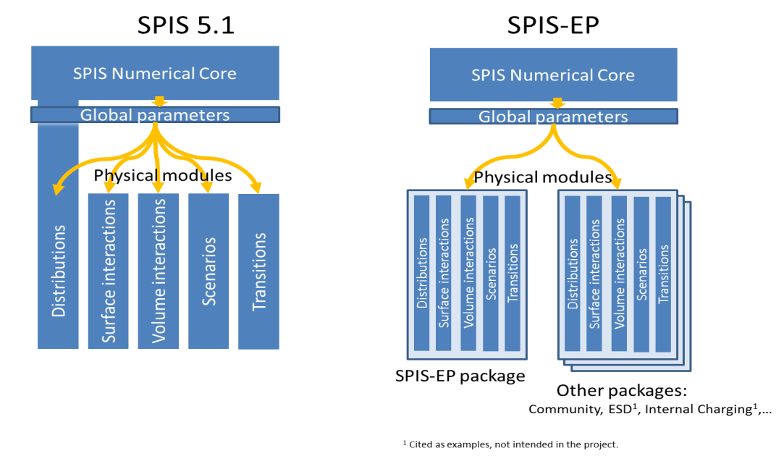
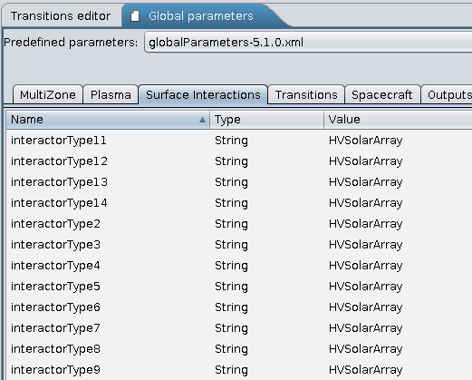
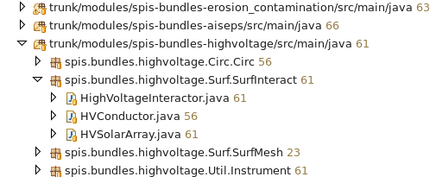
Bundles for SPIS-NUM
How does it work:
_ standardized API: the classes that may be called by the core (initialization classes or UI defined objects) have a clearly defined signature that must be strictly followed.
_ Easy to add to SPIS:
for users, just copy the .jar in the spis/lib folder to add the module
for developers, just need to add SPIS-Core.jar as a dependency
Simulation of the electric thruster plume and of its interaction with the spacecraft

Slide 8
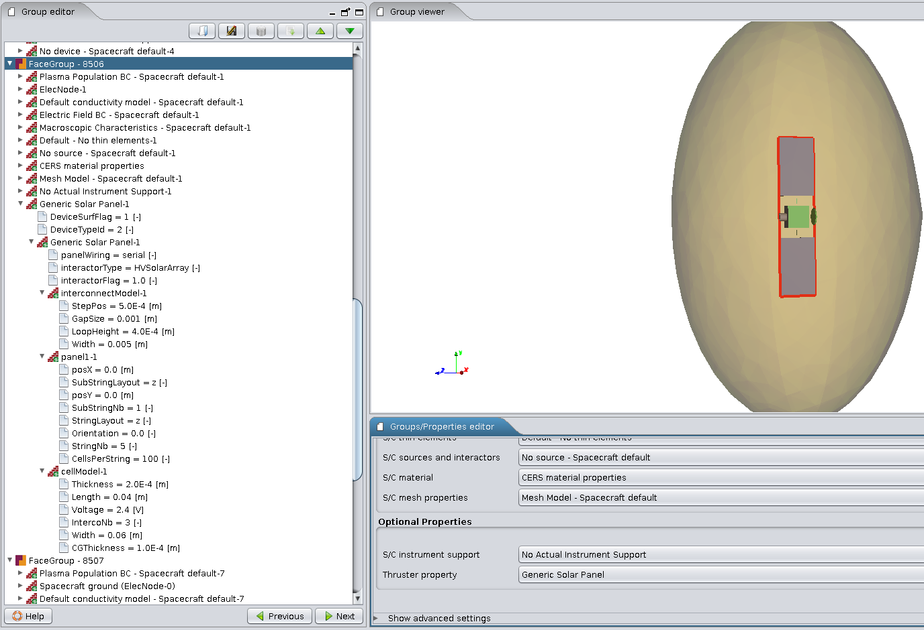
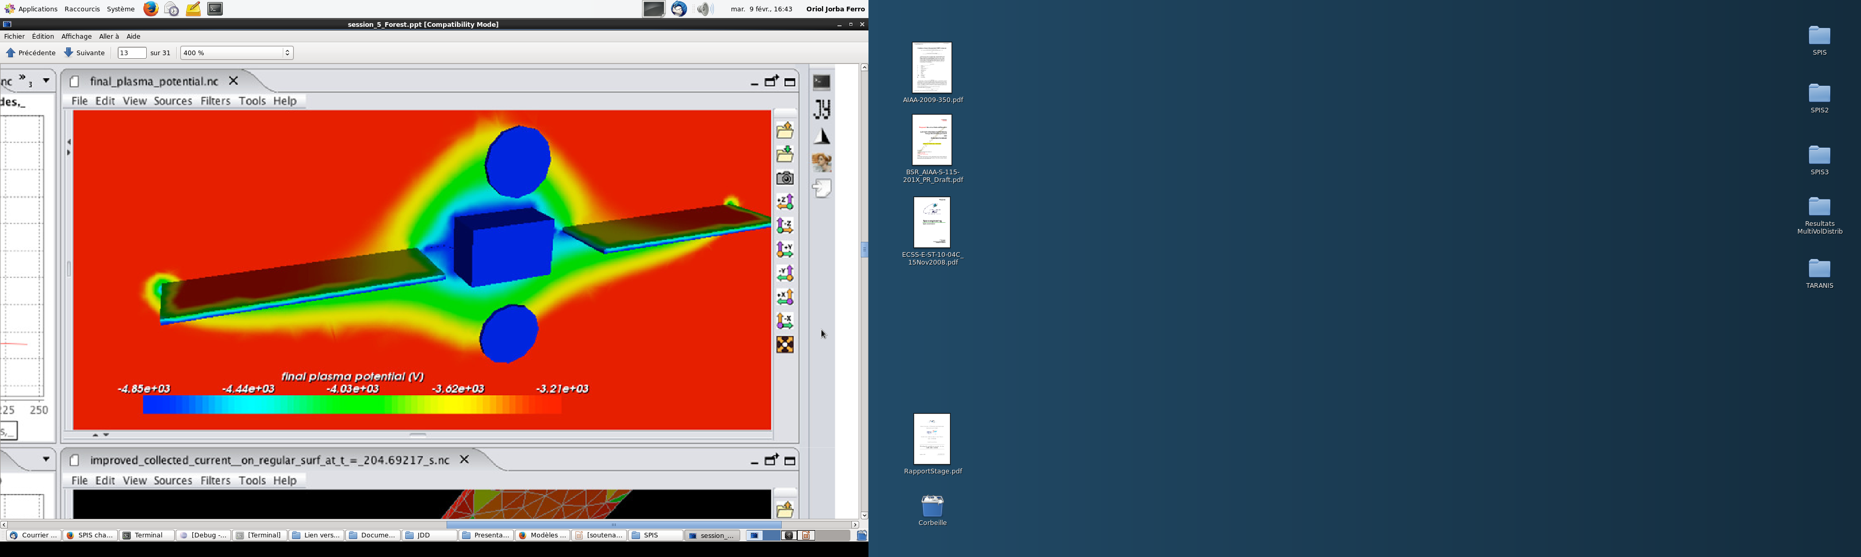
SPIS UI: Defining surface interactions
New way of defining surface interactions:
select a spacecraft surface in the group editor
define a “device property” with the name of the interactor
enter the interactor parameters like the material properties
8
Simulation of the electric thruster plume and of its interaction with the spacecraft

Slide 9
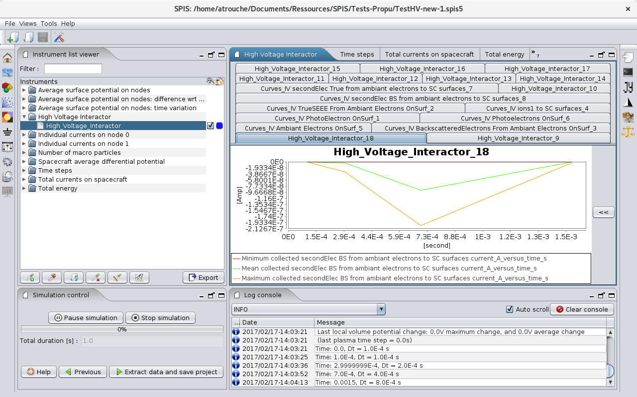
SPIS UI: Live monitoring and control of interactions
Interactors may have associated instruments which are automatically set by SPIS
They may have modifiable parameters that may be changed by editing the instrument
9
Simulation of the electric thruster plume and of its interaction with the spacecraft

Slide 10
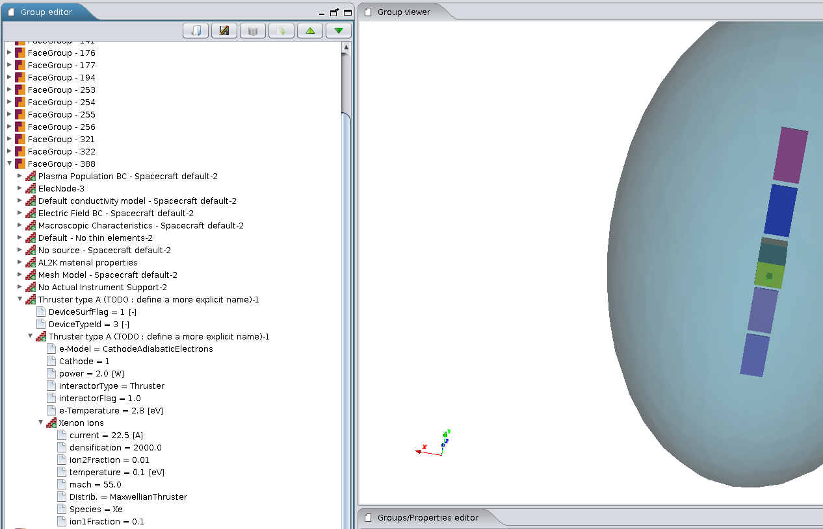
Thruster and cathode definition
Apply the interactor “Thruster” to the surface corresponding to the thruster
Define all the ion/neutral species
(several can be defined at once if they are ionized fractions of each other)
Define the surface distributions
and the related parameters
(can be used for legacy distrib.
like AISEPS’s)
New interactors allows complex
distributions (ex: f(e,α), f(e,r),…)
Possible to associate a cathode
and a cathode electron model
Fluid Method
(Poisson - Boltzmann)
Very fast
No statistical noise
Soft stability conditions
Not always accurate:
  Thermic equilibrium
  Isotropic
10
Simulation of the electric thruster plume and of its interaction with the spacecraft

Slide 11
Electron cooling model implementation:
Quasi – neutral approximation at global scale
In the quasi neutral approximation
n_{e}=n_{i}
No net charges: the electric potential balance the thermal pressure forces:
q dV_{qn} = k/n dn_{e}T_{e}
Not all potential are possible in this model.
Highly negative potentials on surface lead to negative temperature.
Electron temperature function of the electron density.
Because of neutrality, also function f of the ion density.
This temperature is assumed to have a smooth spatial variation:
T_{e}=f_{smoothed} (n_{i})
f monotonic and continuous to compute the quasi-neutral electron density: n_{e,qn} = f⁻¹(T_{e}) ~ n_{i}
Simulation of the electric thruster plume and of its interaction with the spacecraft

Slide 12
Electron cooling model implementation:
Isothermal Poisson-Boltzmann approximation at local scale
The electron density may not be equal to the ion density locally:
n_{e} = n_{e,qn} + δn_{e}
Solving Poisson equation:
e(n_{e} -n_{e,qn})/ε₀=ΔV~(V-V_{qn})/λ_{D}²
n_{e}/n_{e,qn} =1+ (n_{e}/n_{e,qn} )e(V-V_{qn})/kT_{e}
n_{e}=n_{e,qn} exp(e(V-V_{qn})/kT_{e})
In this model, n_{e,qn}, V_{qn} and T_{e} are function of the ion density, the mathematical form of the above equation is exactly the same as that of the usual Maxwell-Boltzmann distribution, except is local and not global.
Contrary to the quasi-neutral case, the Poisson equation is solved explicitly (even if the electron density contribution to the Poisson equation can be implicited). It is possible to simulate non-neutral sheaths close to polarized surfaces.
Simulation of the electric thruster plume and of its interaction with the spacecraft

Slide 13
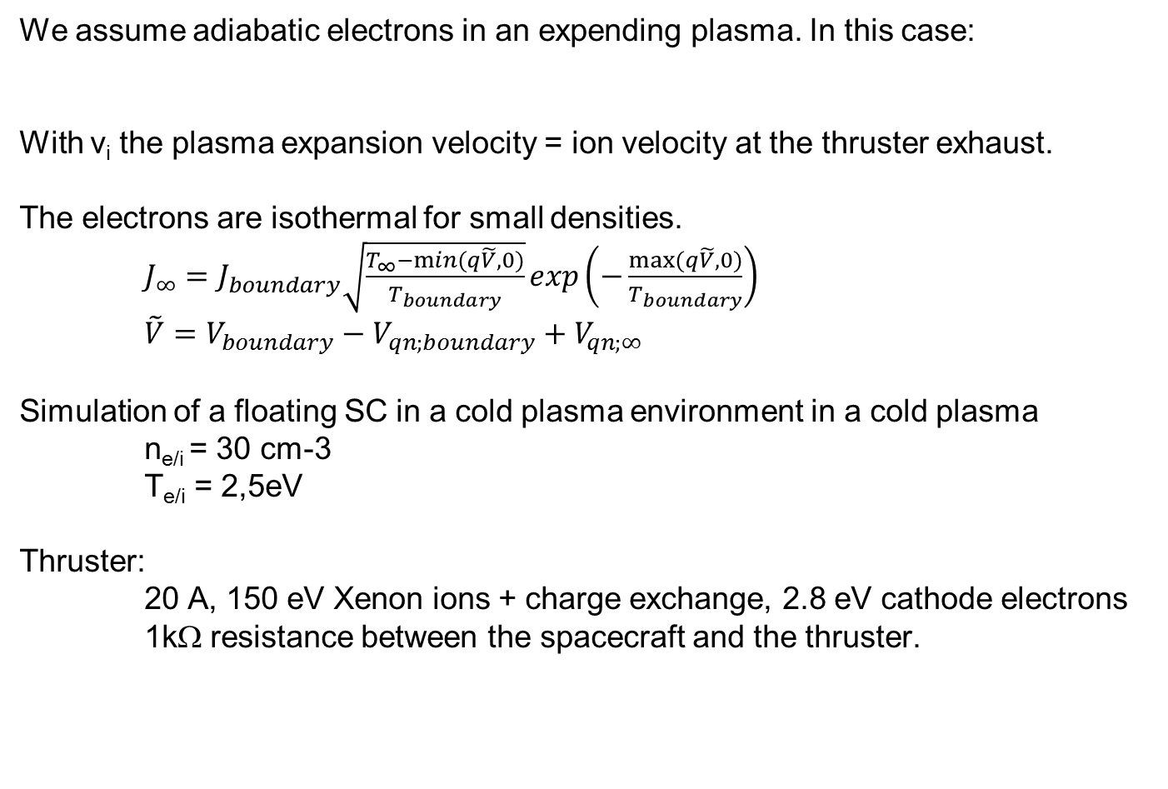
Electron cooling model implementation:
Test with adiabatic electrons
We assume adiabatic electrons in an expending plasma. In this case:
With v_{i} the plasma expansion velocity = ion velocity at the thruster exhaust.
The electrons are isothermal for small densities.
$J_{∞}=J_{boundary}\sqrt{\frac{T_{∞}−min⁡(q\tilde{V},0)}{T_{boundary}}}exp\left(−\frac{max⁡(q\tilde{V},0)}{T_{boundary}}\right)$
$\tilde{V}=V_{boundary}−V_{qn;boundary}+V_{qn;∞}$
Simulation of a floating SC in a cold plasma environment in a cold plasma
n_{e/i} = 30 cm-3
T_{e/i} = 2,5eV
Thruster:
20 A, 150 eV Xenon ions + charge exchange, 2.8 eV cathode electrons
1kΩ resistance between the spacecraft and the thruster.
Simulation of the electric thruster plume and of its interaction with the spacecraft

Slide 14
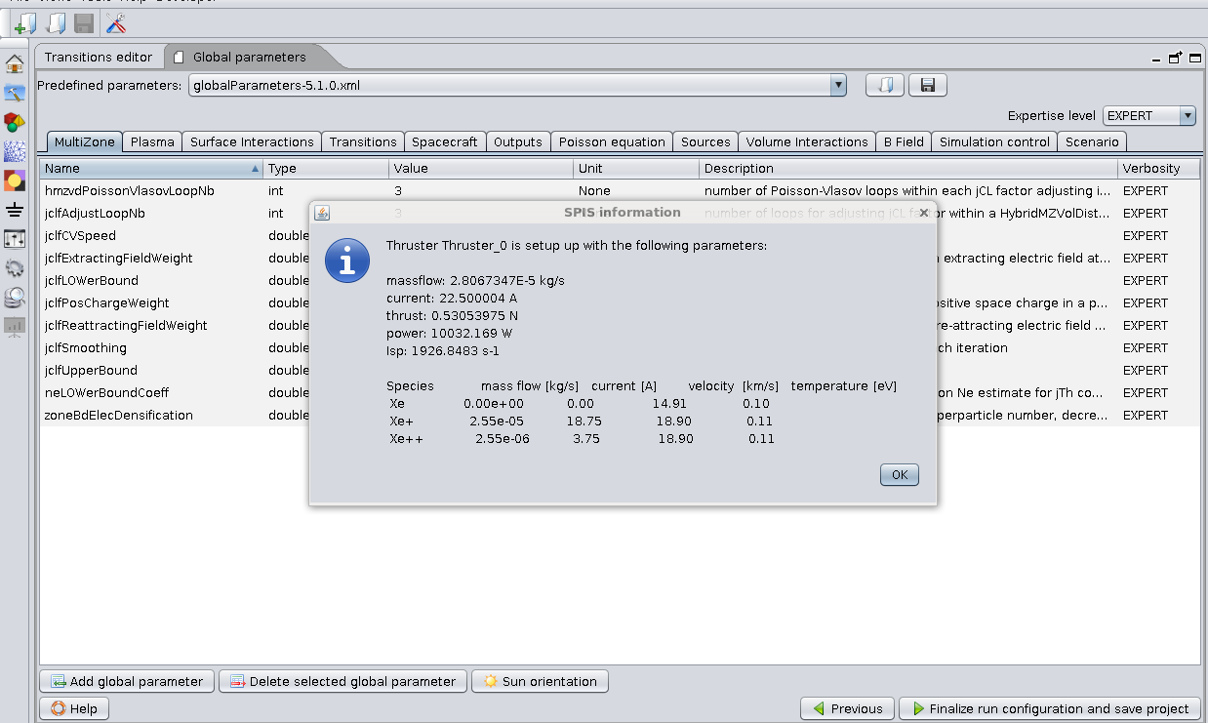
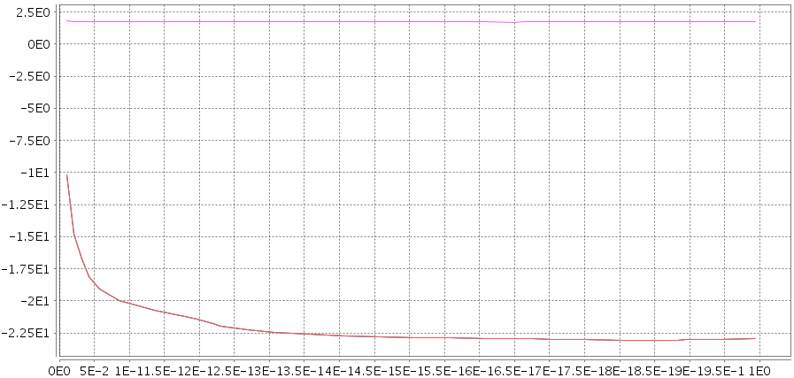
Electron cooling model implementation:
Test with adiabatic electrons
Thruster / cathode
The thruster parameters are
automatically computed
Potential (V)
Spacecraft
Time (s)
Simulation of the electric thruster plume and of its interaction with the spacecraft

Slide 15
Cathode electrons
Log density Temperature
Polytropic
index
15
Simulation of the electric thruster plume and of its interaction with the spacecraft

Slide 16
Thruster ions
Xe⁺
Xe⁺⁺
CEX
16
Simulation of the electric thruster plume and of its interaction with the spacecraft

Slide 17
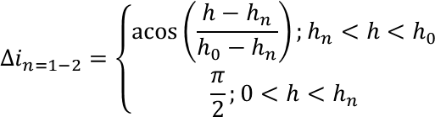
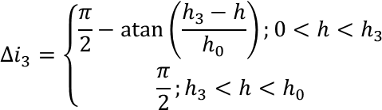
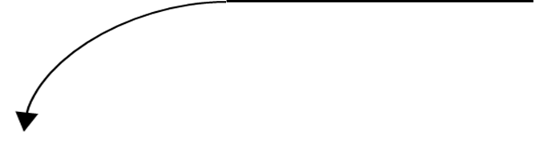
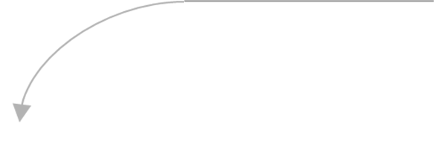
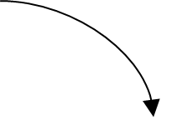

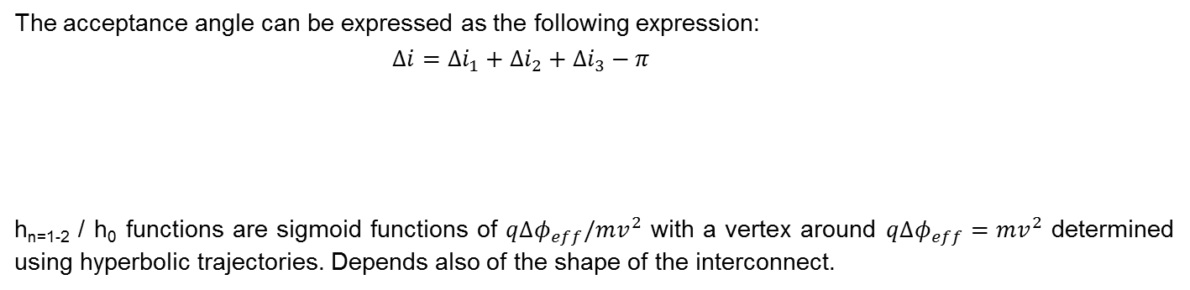
Current collection by exposed conductors
Modified OML Law for ambient species (acceptance angle):
OML: maximum impact parameter h₀. Effective collection surface multiplied by h₀/r.
Works for a cylinder in free space, particles arrive from all directions.
But for an interconnector on a solar panel, only some directions of arrival are possible.
The acceptance angle can be expressed as the following expression:
$∆i=∆i_{1}+∆i_{2}+∆i_{3}−π$
h_{n=1-2} / h₀ functions are sigmoid functions of $q∆φ_{eff}/mv^{2}$ with a vertex around $q∆φ_{eff}=mv^{2}$ determined using hyperbolic trajectories. Depends also of the shape of the interconnect.
h₁
h₂
h₃
Cover glass
Cell
Simulation of the electric thruster plume and of its interaction with the spacecraft

Slide 18
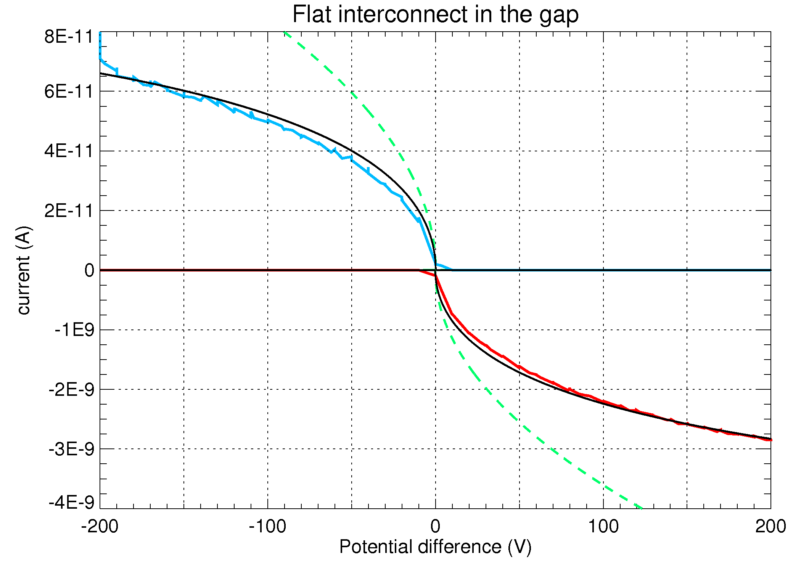
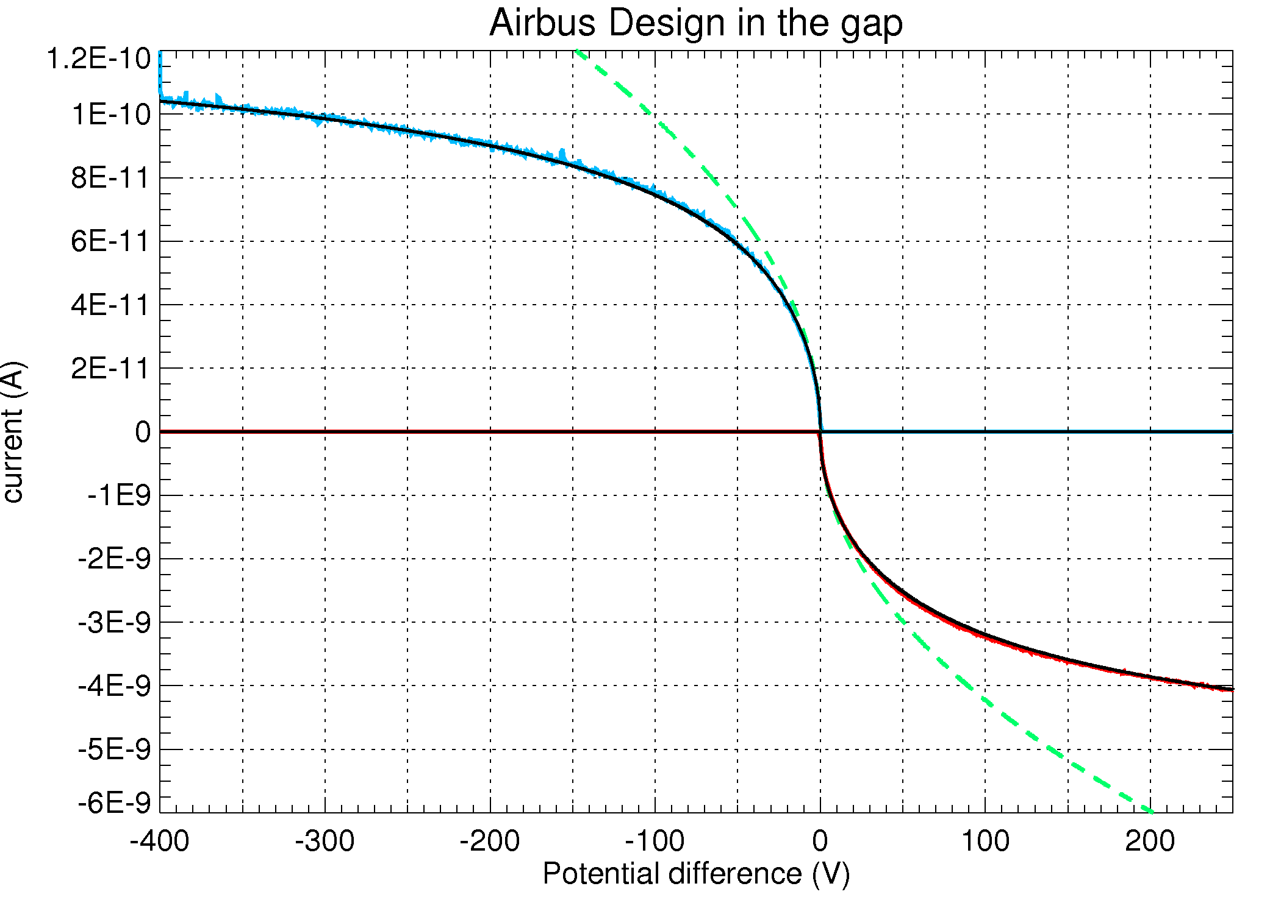
Comparison model – Simulations
Geometrical saturation of the collected current:
Curved interconnect in the gap
The model reproduces well the collected currents.
Analytic model implemented in SPIS to perform simulations at the spacecraft scale.
Simulation of the electric thruster plume and of its interaction with the spacecraft

Slide 19
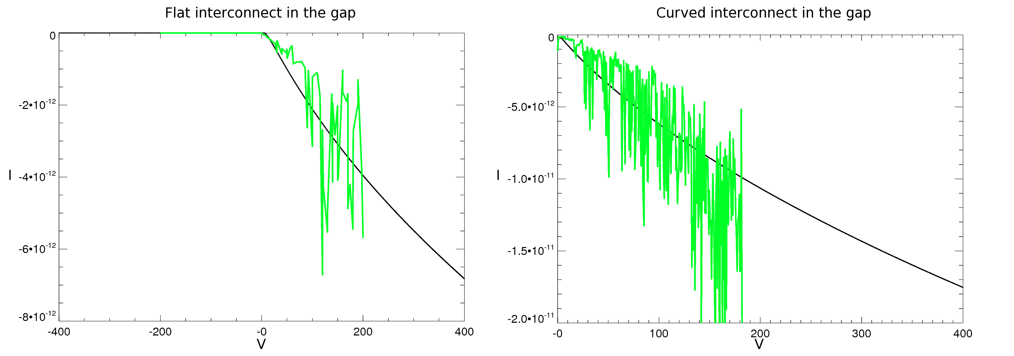
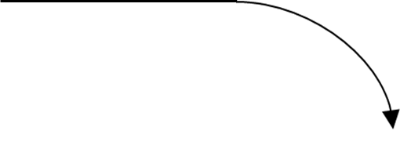

Current collection by exposed conductors
Modified OML Law for secondary species (acceptance angle):
Same calculation than before of h₂ and h₃ but for a particle origin on the cover glass surface
h₂
Cover glass
Cell
h₃
Simulation of the electric thruster plume and of its interaction with the spacecraft

Slide 20
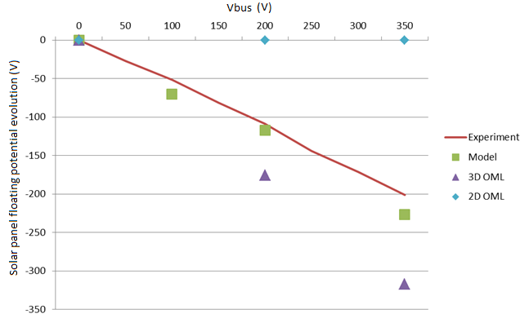
Comparison Experiment– Simulations
Interconnects represent ~1% of the surface
But their polarity determines that of the whole panel.
Simulations performed at various Vbus voltage with plasma source ~20V and 2mA
Simulation of the electric thruster plume and of its interaction with the spacecraft

Slide 21
SPIS UI: Defining surface interactions
Possible to define the cells and interconnects geometry
Limited description of the string layout
(multiple subpanels, substrings // or zigzag layout)
21
Simulation of the electric thruster plume and of its interaction with the spacecraft

Slide 22
Progress on the erosion and contamination
_ sub-cycling on volume interaction: volume interactions now computed each time a particle enters a new mesh cell. Test on dust’s gravitational and photon pressure forces
_ view factor computation: visibility of each pairs of mesh nodes pre-computed in an efficient way. Used to project surface and volume distributions on surfaces and volumes. Tested on the spacecraft lighting. Much faster than current PIC sampling once node pre-computed.
Maybe a bit less precise, but much faster and less noise => not to be used for lighting by default but ok for erosion/contamination by neutrals.
Simulation of the electric thruster plume and of its interaction with the spacecraft

Slide 23
Conclusion
New version of SPIS will bring a lot of improvements:
- modularity
- performance
- simplicity of use
- new physics
Should be released next year:
we are looking forward to have you using it!
NB:
you are welcome to provide feedback on new features
parameter setting in group editor may be generalized if returns are good
Simulation of the electric thruster plume and of its interaction with the spacecraft

